Slide 1
Permissions for Usage
Summary Overview Slides for the
PUNCH Outreach Plan
NOTE: If you are receiving a cloud link rather than an attachment, it is necessary to download this file before you review it so that the PowerPoint graphics and animations work properly.
The content of this presentation is NOT for public audiences. It is intended only for the information of PUNCH Outreach partners, collaborators, advisors, and NASA program officers to help them come up to speed on the NASA-approved PUNCH Outreach Plan.
Please send questions, comments, or requests for other uses of this content to:
cherilynn.morrow@gmail.com
UPDATED as of 15 May 2021

Slide 2
Summary Overview Slides for the
PUNCH Outreach Plan
Cherilynn Morrow, PhD
NASA PUNCH Outreach Director
SwRI Consultant
These slides provide a self-directed, self-paced overview of the PUNCH Outreach Plan and thus have more text associated with them than would be appropriate for an oral presentation.
Please send questions or comments to cherilynn.morrow@gmail.com
UPDATED as of 15 May 2021

Slide 3
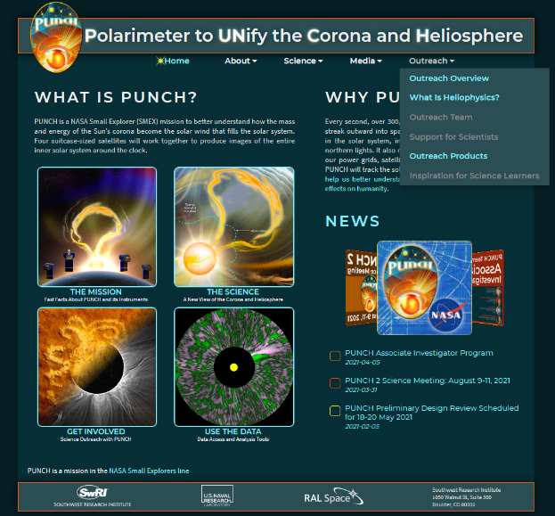
Link to live website is:
PUNCH is a NASA Small Explorer mission to better understand how the mass and energy of the Sun’s outermost atmosphere (corona) becomes the solar wind that fills the Solar System. The corona is the part of the Sun we see during a total solar eclipse.
There is already a start on the outreach dimension of the PUNCH website which was developed during the mission’s Phase B in a close and mutually beneficial collaboration among the Outreach Lead, Project Scientist, and PUNCH PI.
The site received a very helpful review by NASA, including contributions from Heliophysics Communications and Education groups.
There are placeholders on the pull-down menu of the PUNCH Outreach tab.
Our web-based PUNCH “Bowl” of Outreach Resources (products and event planning guides) will be enacted here under “Outreach Products”.
We will also include resources to support PUNCH scientists in their outreach contributions.
https://punch.spaceops.swri.org/
PUNCH Outreach Plan – Self Directed Summary Overview
cherilynn.morrow@gmail.com
Dr. Cherilynn Morrow 8 April 2021
3

Slide 4
PUNCH Outreach is founded on authentic needs & opportunities
“I applaud the work of the solar scientists for many reasons, but in particular because I know their work will augment and enhance Native Traditional Knowledge. It will expand and complement the mystery explored by our Puebloan Ancestors. “
Phillip Tuwaletstiwa, Member of the Hopi Tribe
Episodic Advisor for PUNCH Outreach
PUNCH Outreach is founded on authentic needs & opportunities among the populations we intend to benefit and learn from.
PUNCH Outreach Plan – Self Directed Summary Overview
cherilynn.morrow@gmail.com
Dr. Cherilynn Morrow 8 April 2021
4

Slide 5
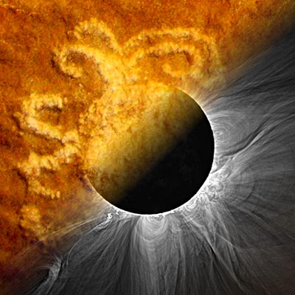
PUNCH Outreach Plan – A Thematic Approach
Began Phase B planning process in March 2020
Surveyed Science Team regarding outreach interests and experience in June 2020
Built a strong regional team with connections to national partners
Chose an Ancient & Modern Sun Watching Theme to broaden participation [The theme is both cross-culturally relevant in the US Southwest as well as more universally appealing as a hook to NASA heliophysics.]
Proposed products and events that take full advantage of the upcoming eclipses as “hooks to heliophysics” yet are also of enduring value
Emphasized the benefits of an outreach project closely integrated with a mission but not focused exclusively on a single mission. [The plan calls for evaluation & documentation of how well we accomplish this for peer review].
Submitted a 5-year plan to NASA in November 2020 proposing to execute an outreach plan in sync with the Phases of the PUNCH mission
Received NASA approval of the plan in late January 2021
The composite graphic represents the Ancient & Modern Sun Watching Theme for PUNCH Outreach.
Integrating an Outreach program within a NASA mission is not a new idea, but our plan offers a powerful new approach to it.
PUNCH Outreach Plan – Self Directed Summary Overview
cherilynn.morrow@gmail.com
Dr. Cherilynn Morrow 8 April 2021
5

Slide 6
The PUNCH Outreach Plan leverages the attributes of the NASA PUNCH Small Explorer mission to extend outreach on the fundamental science of heliophysics to underrepresented and underserved learners in the American Southwest and to the broader public in that region. The populations we have chosen to emphasize are: Native American and Hispanic/Latinx youth and families, Girls in STEM, and the Blind and Visually Impaired (B/VI). These choices were motivated by the three considerations in the Venn diagram (at right). Attuning to the needs and opportunities of these historically marginalized populations has led to a multi-cultural, multi-sensory, arts-integrated outreach plan for PUNCH that is enriching for all people in all communities. Our products and events are designed to “Shine a Light on Diverse Views of the Sun,” be they scientific, cultural, historic, or the result of first-person observations. A regional consortium of five planetariums & science centers in four states (CO, NM, AZ, UT) is partnered with the Southwest Research Institute (SwRI) to carry out the PUNCH outreach plan in close collaboration with the PUNCH mission team. PUNCH Outreach is poised for national impact with an Ancient & Modern Sun Watching theme, which is cross-culturally relevant in the Southwest yet also more universally appealing. There is worldwide evidence that all human beings are descended from Sun watching cultures, and PUNCH Outreach portrays NASA’s exploration of the Sun as a natural extension of humanity’s long-lived dedication to observing the Sun’s rhythms and mysteries. PUNCH Outreach includes partnership with Parker Solar Probe and other NASA missions and programs, plus alliance with Chaco Culture National Historical Park - a World Heritage Site in the northwestern New Mexico that offers copious evidence for ancient Sun-watching.
PUNCH Outreach Overview: Shining a Light on Diverse Views of the Sun
Needs of learners in the Southwest
Strengths of partner organizations
Nature of PUNCH data & science team
The PUNCH Outreach plan includes partners, products, and participants based on consideration of the factors (circles) of this Venn diagram. The plan’s design reflects the intersection of all three (yellow star).
PUNCH Outreach Plan – Self Directed Summary Overview
cherilynn.morrow@gmail.com
Dr. Cherilynn Morrow 8 April 2021
6

Slide 7
OVERARCHING GOAL for PUNCH OUTREACH:
To leverage the PUNCH mission to inspire historically marginalized youth in the Southwestern US to learn about NASA heliophysics in ways that honor their identities related to culture, gender, and disability, and thereby increase their confidence and consideration for pursuing STEM career pathways
PUNCH Outreach Plan – Self Directed Summary Overview
cherilynn.morrow@gmail.com
Dr. Cherilynn Morrow 8 April 2021
7
NASA PUNCH Outreach Plan – Figures & Slides
cherilynn.morrow@gmail.com
Dr. Cherilynn Morrow 28 February 2021

Slide 8
OBJECTIVES in SUPPORT of the OVERARCHING PUNCH OUTREACH GOAL:
Objective 1: SUPPORT for MISSION TEAM ENGAGEMENT
To support the PUNCH mission team in contributing its expertise, data, and discoveries to high-impact opportunities in heliophysics outreach and communications.
Objective 2: SUPPORT for OUTREACH PARTNERSHIPS of MUTUAL BENEFIT
To leverage the strengths and enhance the capacities of planetariums and science centers to share NASA heliophysics with underserved & underrepresented populations, including Native American and Hispanic/Latinx youth & families, Girls in STEM, and the Blind & Visually Impaired, as well as the broader population.
Objective 3: OUTREACH PRODUCTS of HIGH IMPACT and ENDURING VALUE
To develop, test, and deliver a multi-sensory, multi-modal, multi-cultural suite of enduring outreach PRODUCTS on the theme of Ancient & Modern Sun Watching with emphasis on NASA heliophysics missions, ancient Sun watching sites in Chaco Culture National Historical Park, and personal observation of the Sun.
Objective 4: REPLICABLE OUTREACH EVENTS
To design, develop, test, and deploy a suite of outreach EVENTS that use PUNCH Outreach products, scientist participation, arts-integration, and opportunities for both direct and indirect solar observation to engage diverse participants in the Ancient & Modern Sun Watching theme and to provide pathways to other NASA-sponsored opportunities related to heliophysics.
Objective 5: BROAD and STRATEGIC DISSEMINATION
To ensure that all resources, products, and event planning guides are accessible and usable by outreach organizations both within and outside the PUNCH Outreach sphere of partnerships, and in particular are useful to institutions who have access to the underserved & underrepresented populations on which PUNCH outreach efforts are focused.
PUNCH Outreach Plan – Self Directed Summary Overview
cherilynn.morrow@gmail.com
Dr. Cherilynn Morrow 8 April 2021
8

Slide 9
The 5 Types of PUNCH Outreach Events have common elements
PUNCH “Bowl” of
Outreach Resources
[Multi-sensory, Multi-modal, Multi-cultural, Multi-format]
Planetarium Films (dome & flat)
STEM & Art Activities Kinesthetic/Embodied Activities
Tactile Objects & Graphics
Animations & Interactives
Sun Watching Kit Designs
Event Planning Guides
Leads to allied NASA resources
Live-Interaction Planetarium Shows
Interactive & embodied options for ALL learners
Girls Scouts and Out-of-School Time Patches & Events
Girls in STEM
Native & Hispanic youth
Community STEAM Events
Emphasis on broadening participation of Native & Latinx youth & families
Chaco Interpretive Materials & Events
Emphasis on visits by regional youth groups
PUNCH public engagement events feature:
access to PUNCH scientists
arts integration
direct & indirect solar observing modalities
multi-sensory activities (audio, visual, tactile, kinesthetic)
news and up-to-date information on mission milestones and discoveries
pathways to more enduring NASA options for STEM engagement including citizen science programs (e.g., Sungrazer – a project to discover comets passing close to the Sun in NASA spacecraft data)
1. Inspired by the visual nature of PUNCH data and the versatility of modern digital films to be rendered in multiple formats for broader dissemination. Embodied learning approaches are motivated by the widely used Kinesthetic Astronomy and the growing Live Interaction movement in the planetarium community to inquiry-based immersive experiences that go beyond passive reception.
Solar Observing Tactiles & Events for the Visually Impaired
Emphasis on learners at B/VI Schools
5. Inspired by the high percentage of Native and Latinx populations in the US Southwest and the demonstrated value of STEM learning with art, language, and embodied activities in cross-cultural contexts.
2. Inspired by a NASA Airborne Ambassador in New Mexico who is an award-winning science instructor developing the first astronomy course in the nation for visually impaired learners.
3. Inspired by the “eclipse” petroglyph at a Chaco Ancestral Puebloan solar observing site that may be humanity’s first recording of an active solar corona in 1097.
4. Inspired by the high number of women in leadership roles for PUNCH and other NASA Heliophysics missions.
PUNCH Outreach Plan – Self Directed Summary Overview
cherilynn.morrow@gmail.com
Dr. Cherilynn Morrow 8 April 2021
9
Notes:
By USGS - http://pubs.usgs.gov/fs/2004/3035/pdf/fs-2004-3035.pdf, Public Domain, https://commons.wikimedia.org/w/index.php?curid=21418041

Slide 10
PUNCH Outreach: Shining a Light on Diverse Views of the Sun
PUNCH Outreach shines a light on diverse views of the Sun. The needs and opportunities of marginalized learners have led us to propose a suite of multi-cultural, multi-sensory (audio, visual, tactile, kinesthetic), arts-integrated products for versatile use in a collection of PUNCH-sponsored community events that stand to be enjoyable and beneficial to all people in all communities, even as they serve the more focused, overarching goal of PUNCH Outreach.
Diverse participants in our community outreach events and live interaction planetarium programs have opportunities to “see” the Sun in multiple ways, including…
through the eyes of an ancient Sun watcher in Chaco via horizon interactions and light & shadow on rock art
through the “eyes” of a NASA spacecraft like PUNCH and other heliophysics missions
through their very own eyes both directly (with eclipse glasses, filters, and solar telescopes) and indirectly (with gnomons, pinhole projectors, UV beads, artistic representations, and scientific imagery)
Envisioned PUNCH Outreach events invite both sighted and B/VI learners to “observe” the Sun in other sensory modalities including tactile, sound, and kinesthetic.
PUNCH Outreach Events increase awareness, appreciation, curiosity, and knowledge about
humanity’s relationship to the Sun;
NASA Heliophysics missions;
ancient Sun-watching practices;
options for personal solar observation;
how art & science are valuable allies.
In all events diverse people can experience honoring of their identities related to culture, gender, or disability as they learn about NASA science.
PUNCH Outreach Plan – Self Directed Summary Overview
cherilynn.morrow@gmail.com
Dr. Cherilynn Morrow 8 April 2021
10

Slide 11
Eight Guiding Principles for the PUNCH Outreach Plan
Engaging outreach expertise in collaboration with mission leadership
Synergizing the Science, Outreach, and Communication Teams (e.g., on website)
Coordinating & synergizing with allied NASA groups & missions
Enacting a thematic approach to broaden participation
Aligning mission attributes with outreach participants, partners, and products
Leveraging strengths & partnerships among multiple institutions
Learning from those we intend to benefit from the start
Using evidence-based practices & integrating evaluative processes
Eight KEY principles guide the development and implementation of the PUNCH Outreach plan.
PUNCH Outreach Plan – Self Directed Summary Overview
cherilynn.morrow@gmail.com
Dr. Cherilynn Morrow 8 April 2021
11

Slide 12
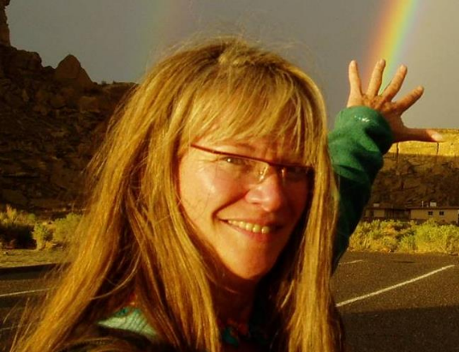
Dr. Cherilynn Morrow - PUNCH Outreach Director
Consultant for the Southwest Research Institute (SwRI)
Since March 2020, Cherilynn Morrow has been under contract with SwRI (reporting to the PUNCH PI, Dr. Craig DeForest and collaborating with the PUNCH Project Scientist, Dr. Sarah Gibson) to build a PUNCH Outreach team and lead the development and implementation of an Outreach plan for the PUNCH mission. The plan was submitted in November 2020 and approved by NASA in January 2021.
Dr. Morrow is an award-winning space and Earth science educator and a solar astrophysicist by training (PhD, 1988 University of Colorado). She worked for more than a decade with NASA and NSF on policies and strategies that support the effective integration of education and public outreach (EPO) programs in scientific research environments, including space science missions.
She has facilitated dozens of workshops and conference sessions for scientists who want to support K-12 and informal education, and hundreds of workshops for educators interested in inquiry-based teaching of space and Earth science that is aligned with research on how people learn.
She is the originator of Kinesthetic Astronomy – a widely adopted, embodied approach to teaching & learning 3-D astronomical concepts that is integral to all domains of the PUNCH Outreach plan. She also sings “Stormy Weather – Solar Style” as part of her AstroJazz repertoire and her love for integrating the arts in STEM education (STEAM). She has guided hundreds of multi-sensory, arts-integrated programs for visitors to Chaco Culture NHP and facilitated dozens of cross-cultural STEM programs for Native American educators and students.
This is Cherilynn in Chaco Culture National Historical Park – a World Heritage site in northwest New Mexico. Her hair is grayer now, but she loves this photo so much she’ll probably never stop using it. Cherilynn has volunteered as an interpreter and/or cultural astronomy research assistant in Chaco for 15+ years.
PUNCH Outreach Plan – Self Directed Summary Overview
cherilynn.morrow@gmail.com
Dr. Cherilynn Morrow 8 April 2021
12

Slide 13
Eight Guiding Principles for the PUNCH Outreach Plan
Engaging outreach expertise in collaboration with mission leadership
Synergizing the Science, Outreach, and Communication Teams (e.g., on website)
Coordinating & synergizing with allied NASA groups & missions
Enacting a thematic approach to broaden participation
Aligning mission attributes with outreach participants, partners, and products
Leveraging strengths & partnerships among multiple institutions
Learning from those we intend to benefit from the start
Using evidence-based practices & integrating evaluative processes
Eight KEY principles guide the development and implementation of the PUNCH Outreach plan
PUNCH Outreach Plan – Self Directed Summary Overview
cherilynn.morrow@gmail.com
Dr. Cherilynn Morrow 8 April 2021
13

Slide 14
Outreach = Public Engagement ≠ NASA Communications
PUNCH Outreach serves as a complementary bridge between the work of newsworthy discoveries that NASA and SwRI Communications address and the more formal support of STEM education that the NASA Science Mission Directorate (SMD) sponsors via its Science Activation (Sci-Act) portfolio.
PUNCH Outreach leverages, complements, and seeks synergy with these other important domains of activity.
PUNCH Outreach also engages PUNCH scientists and other heliophysicists in a variety of valuable roles
PUNCH Outreach
[focuses on diverse public engagement with heliophysics people, science, data]
NASA & SwRI Communications
[emphasizes support for the news media]
NASA STEM support programs
[emphasizes support for STEM education]
PUNCH Outreach complements and supports the work of NASA Communications and other NASA-sponsored STEM efforts.
PUNCH Outreach Plan – Self Directed Summary Overview
cherilynn.morrow@gmail.com
Dr. Cherilynn Morrow 8 April 2021
14
Notes:
PUNCH Outreach serves as a complementary bridge between the work of newsworthy discoveries that NASA and SWRI Communications address and the more formal support of STEM education that NASA SMD sponsors via its Science Activation (Sci-Act) portfolio. Figure 6 documents the Sci-Act groups with whom we have coordinated thus far. PUNCH Outreach leverages, complements, and supports these other important domains of activity. Our planned public engagement events take full advantage of the excitement of news and up-to-date information on PUNCH milestones and discoveries and also promote awareness of more enduring NASA options for STEM engagement including citizen science programs (e.g. Sungrazer), internships, or opportunities with MAIANSE – NASA’s program “to increase American Indian and Alaska Native engagement in STEM through authentic and unique NASA experiences.”

Slide 15
Diverse Roles for Scientists in Outreach
Diverse roles for scientists and other Subject Matter Experts (SMEs) in PUNCH Outreach
Facilitator of scientific data access for planetarium films and digital interactive lessons
Advisor, reviewer, or collaborator on outreach product development
Presenter, Artist, or Ask-a-Solar-Astronomer at outreach events for Girl Scouts, Latinx/Native American youth & families, Blind/Visually Impaired, Chaco visitors
Featured guest for the Scientists as Hobbyists and Artists (Sci-HArt) podcast series
Solar telescope operator at outreach event
Episodic advisor for Girl Scouts earning a Sun-watching patch
Professional developer of outreach team in heliophysics
Mission or scientific leader that encourages outreach participation among peers
Interested scientists on all NASA Heliophysics Missions are welcome!
Please contact me with your interest in contributing to PUNCH Outreach
PUNCH Outreach Plan – Self Directed Summary Overview
cherilynn.morrow@gmail.com
Dr. Cherilynn Morrow 8 April 2021
15

Slide 16
PUNCH Outreach Plan – Science Team Enthusiasm!
Survey of the PUNCH Science Team (N=30) 1-3 June 2020 | I love to teach | I love to communicate my science to diverse audiences | I enjoy being a resource for the news media
% who “Agree” or “Strongly Agree” | > 60% | > 85% | > 65%
Survey of the PUNCH Science Team (N=30) 1-3 June 2020 | Never been a teacher | Never given a public talk | Never worked with news media
% reporting | ~ 35% | < 10% | < 20%
PUNCH leadership and the science team are providing an environment where an integrated program of outreach can THRIVE!
PUNCH Outreach Plan – Self Directed Summary Overview
cherilynn.morrow@gmail.com
Dr. Cherilynn Morrow 8 April 2021
16

Slide 17
The PUNCH Science Team has the interest and experience to be effective in PUNCH outreach domains!
PUNCH Outreach
2.
Live Interaction in Planetariums
3.
Girl Scouts
&
Out-of-School Time programs
1.
Indigenous Engagement
4.
Chaco Interpretation
Providing data access
27 of 30 interested
14 of these experienced
Science consulting
24 of 30 interested
18 of these experienced
These data are based on the results of a June 2020 written survey of the PUNCH Science Team (N=30) regarding their outreach interests and experience.
NOTE: The survey was made before visually impaired learners become a priority for PUNCH Outreach.
25 of 30 interested
2 of these experienced
20 of 30 interested
8 of these experienced
15 of 30 interested
5 of these experienced
PUNCH Outreach Plan – Self Directed Summary Overview
cherilynn.morrow@gmail.com
Dr. Cherilynn Morrow 8 April 2021
17
Notes:
By USGS - http://pubs.usgs.gov/fs/2004/3035/pdf/fs-2004-3035.pdf, Public Domain, https://commons.wikimedia.org/w/index.php?curid=21418041

Slide 18
Support from our Collaborators and Advisors
“STEM has become a foundational component to the Girl Scout Experience… It is the goal of our growing STEM initiative to deliver high-quality, hands-on experiences for girls to investigate science topics and to directly connect them to STEM professionals working in the field, regardless of a girl’s race, ethnicity, socioeconomic background, disability, or geographic location.”
Alexandria Burnquist, STEM Program Manager
New Mexico Trails Girl Scout Council
PUNCH Outreach Collaborator
“Girls & volunteers benefit greatly from STEM professionals, such as PUNCH scientists, who can serve as “Episodic Volunteers,” providing expertise on an occasional or periodic basis rather than in an ongoing way (like a Troop Leader). This is vital to girls working on space science badges & patches.”
Pamela Harman, Education Director, SETI Institute
PI for NASA-GSUSA, “Reach for the Stars”
Chair, PUNCH Outreach Advisory Board
PUNCH Outreach is founded on authentic needs & opportunities among the populations we intend to benefit and learn from.
PUNCH Outreach Plan – Self Directed Summary Overview
cherilynn.morrow@gmail.com
Dr. Cherilynn Morrow 8 April 2021
18

Slide 19
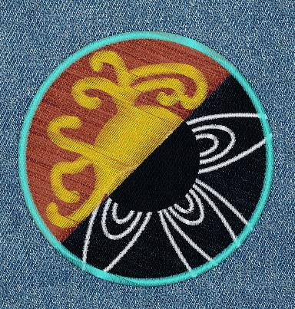
PUNCH Outreach Plan – Girl Scout Patch
Design idea for an Ancient & Modern
Sun-watching patch for Girl Scouts.
Ancient & Modern Sun Watching Theme
Outreach icon for the PUNCH Website
PUNCH Outreach Plan – Self Directed Summary Overview
cherilynn.morrow@gmail.com
Dr. Cherilynn Morrow 8 April 2021
19

Slide 20
PUNCH Outreach: Exploring the Artistry of PUNCH Scientists
Half of the respondents (15/30) to the survey of PUNCH scientists regarding their outreach experience indicated interest in “using their own artistic talents in science outreach.”
Dr. Heather Elliott is a PUNCH Co-Investigator at SwRI Headquarters in San Antonio, TX who studies Co-Rotating Interaction Regions – great Archimedean spirals in interplanetary space that are formed by a combination of the Sun’s rotation, magnetic field, and solar outflows of faster and slower speeds.
Dr. Elliott is also a dancer who can create and sustain beautiful shapes with her veils that are reminiscent of features in the solar corona and heliosphere. She has expressed interest in contributing an art-science element to our proposed “Community STEAM Events” and/or “Girl Scout Patch Events”.
Dr. Heather Elliott, is a PUNCH Science Co-Investigator who studies Co-Rotating Interaction Regions in the heliosphere.
PUNCH Outreach Plan – Self Directed Summary Overview
cherilynn.morrow@gmail.com
Dr. Cherilynn Morrow 8 April 2021
20

Slide 21
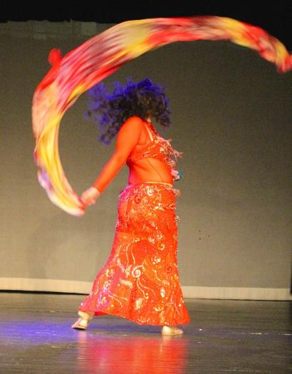
PUNCH Outreach: Exploring the Artistry of PUNCH Scientists
Dr. Heather Elliott – PUNCH Co-Investigator, SwRI San Antonio, TX
Dr. Elliott studies Co-Rotating Interaction Regions in the heliosphere.
The shapes and movement of her veils can represent features in the solar corona and solar wind.
Dr. Elliot has expressed interest in contributing to our Girl Scout patch events and cross-cultural Community STEAM events. STEAM = Science, Technology, Engineering, Arts, Mathematics
PUNCH Outreach Plan – Self Directed Summary Overview
cherilynn.morrow@gmail.com
Dr. Cherilynn Morrow 8 April 2021
21

Slide 22
Support from our Collaborators and Advisors
“Hispanic/Latinx children and families need opportunities to examine and learn about their cultural histories and stories while learning about science. Creative, holistic experiences in culture, art, science, and personal histories lead to the creative thought needed for the cultivation of future working scientists.”
Elena Baca, Latina STEAM Educator
National Hispanic Cultural Center, Albuquerque, NM
Member, PUNCH Outreach Advisory Board
PUNCH Outreach is founded on authentic needs & opportunities among the populations we intend to benefit and learn from.
PUNCH Outreach Plan – Self Directed Summary Overview
cherilynn.morrow@gmail.com
Dr. Cherilynn Morrow 8 April 2021
22

Slide 23
Eight Guiding Principles for the PUNCH Outreach Plan
Engaging outreach expertise in collaboration with mission leadership
Synergizing the Science, Outreach, and Communication Teams (e.g., on website)
Coordinating & synergizing with allied NASA groups & missions
Enacting a thematic approach to broaden participation
Aligning mission attributes with outreach participants, partners, and products
Leveraging strengths & partnerships among multiple institutions
Learning from those we intend to benefit from the start
Using evidence-based practices & integrating evaluative processes
Eight KEY principles guide the development and implementation of the PUNCH Outreach plan.
PUNCH Outreach Plan – Self Directed Summary Overview
cherilynn.morrow@gmail.com
Dr. Cherilynn Morrow 8 April 2021
23

Slide 24
Interconnections with Existing NASA programs
Name of NASA program | NASA connection | Points of Contact | Role in PUNCH Outreach
HEAT | NASA & Heliophysics Education | Carolyn Ng | Liaison
Reach for the Stars | NASA & Girl Scouts | Pamela Harman | Advisory Board
PLANETS | NASA & Out-of-School time | Dr. Joelle Clark | Advisory Board
Earth to Sky | NASA & National Parks | Anita Davis & Genevieve deMessieres | Informal Advisors
Infiniscope | NASA & Digital Interactives | Geoffrey Bruce | Informal Advisor
Eclipse Soundscapes: Citizen Science Project | NASA & Accessibility for Visually Impaired | Trae Winter and MaryKay Severino | Dissemination partner
MAIANSE | NASA & Native America | Bonnie Murray | Dissemination partner
The Table lists the NASA-sponsored Science Activation groups (Sci-Acts) and the STEM Engagement group (MAIANSE) with whom we have consulted and explored relationships of mutual benefit during the development of the PUNCH Outreach plan. These programs are part of the PUNCH Outreach & Communications Alliance (POCA) along with other Dissemination partners who support PUNCH Outreach on a “no-exchange-of-funds” basis and enhance our potential for national impact.
PUNCH Outreach Plan – Self Directed Summary Overview
cherilynn.morrow@gmail.com
Dr. Cherilynn Morrow 8 April 2021
24

Slide 25
Eight Guiding Principles for the PUNCH Outreach Plan
Engaging outreach expertise in collaboration with mission leadership
Synergizing the Science, Outreach, and Communication Teams (e.g., on website)
Coordinating & synergizing with allied NASA groups & missions
Enacting a thematic approach to broaden participation
Aligning mission attributes with outreach participants, partners, and products
Leveraging strengths & partnerships among multiple institutions
Learning from those we intend to benefit from the start
Using evidence-based practices & integrating evaluative processes
Eight KEY principles guide the development and implementation of the PUNCH Outreach plan.
PUNCH Outreach Plan – Self Directed Summary Overview
cherilynn.morrow@gmail.com
Dr. Cherilynn Morrow 8 April 2021
25

Slide 26
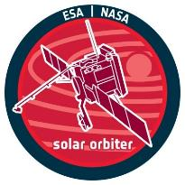
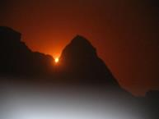
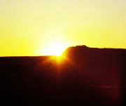
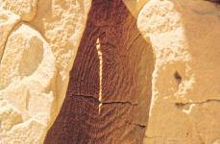
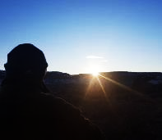
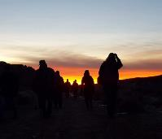
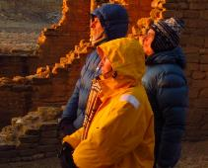
NASA Heliophysics Missions
Elements of the Ancient & Modern Sun Watching Theme
Ancient Sun Watching in Chaco Culture NHP
Personal Sun Watching in modern times
PUNCH Outreach Plan – Self Directed Summary Overview
cherilynn.morrow@gmail.com
Dr. Cherilynn Morrow 8 April 2021
26

Slide 27
Appreciation for the Ancient & Modern Sun Watching Theme
“I greatly appreciate the Ancient and Modern Sun watching theme you have chosen and that you will be encouraging children to observe the sunrise and sunset. The Dine’ people honor the Sun (Johonnaa) ..… I see using the context of a NASA mission to explore the Sun interwoven with cultural traditions as beneficial….”
Verna Tallsalt, Low Mountain, AZ
Navajo Culture & Language Consultant
Member, PUNCH Outreach Advisory Board
“Girl Scouts encourages girls to spend quality time outdoors and increase their exposure to nature to help them thrive. A recent challenge patch was designed to encourage girls to go outside and look up!”
Pamela Harman, Education Director, SETI Institute
PI for NASA-GSUSA, “Reach for the Stars”
Chair, PUNCH Outreach Advisory Board
PUNCH Outreach is founded on authentic needs & opportunities among the populations we intend to benefit and learn from.
PUNCH Outreach Plan – Self Directed Summary Overview
cherilynn.morrow@gmail.com
Dr. Cherilynn Morrow 8 April 2021
27

Slide 28
Appreciation for the Ancient & Modern Sun Watching Theme
Dr. Nunn (quoted below) has committed to gather Hispanic youth who consult on PUNCH Outreach products and events intended for them and their families.
“I am fascinated about the proposed plan that encompasses the theme of Ancient & Modern Sun Watching with a focus on the ancient solar observatories of Chaco Culture National Historical Park and NASA Heliophysics missions like PUNCH that will be exploring the Sun’s corona during the upcoming solar eclipses in 2023 and 2024.
We are passionate about this collaborative effort that is not only innovative but will also ensure the presentation of products and events that will be inclusive and relevant to historically underserved populations and in so doing, enhance the value of our efforts for all people in all communities.”
Tey Marianna Nunn, PhD
Director and Chief Curator
National Hispanic Cultural Center Art Museum
Albuquerque, NM
PUNCH Outreach is founded on authentic needs & opportunities among the populations we intend to benefit and learn from.
PUNCH Outreach Plan – Self Directed Summary Overview
cherilynn.morrow@gmail.com
Dr. Cherilynn Morrow 8 April 2021
28

Slide 29
Support from our Collaborators and Advisors
Mr. Aragon (quoted below) has committed to gather Native American youth who consult on PUNCH Outreach products and events intended for them and their families.
“I am interested in the overlap of cultural significance and NASA science learning that is possible, including potential links to the Acoma language revitalization project, emphasis on our ancestral connection to Chaco, and increased understanding of the movement of the Sun through its cycles. This project can provide a way for our Acoma and Laguna students to experience NASA science and envision a future career in science, without losing touch with their culture.”
Joe Aragon
STEM Educator (retired), Acoma Pueblo, NM
PUNCH Outreach Cross-cultural consultant
PUNCH Outreach is founded on authentic needs & opportunities among the populations we intend to benefit and learn from.
PUNCH Outreach Plan – Self Directed Summary Overview
cherilynn.morrow@gmail.com
Dr. Cherilynn Morrow 8 April 2021
29

Slide 30
PUNCH Outreach – Challenges and Rewards of Crossing Cultures
Crossing cultures:
Finding common ground Learning from differences
1. Native American Culture
2. National Park Service
3. NASA
Indian cultures of the US Southwest
PUNCH & Other Heliophysics Missions
CHACO Culture National Historical Park
PUNCH Outreach Plan – Self Directed Summary Overview
cherilynn.morrow@gmail.com
Dr. Cherilynn Morrow 8 April 2021
30

Slide 31
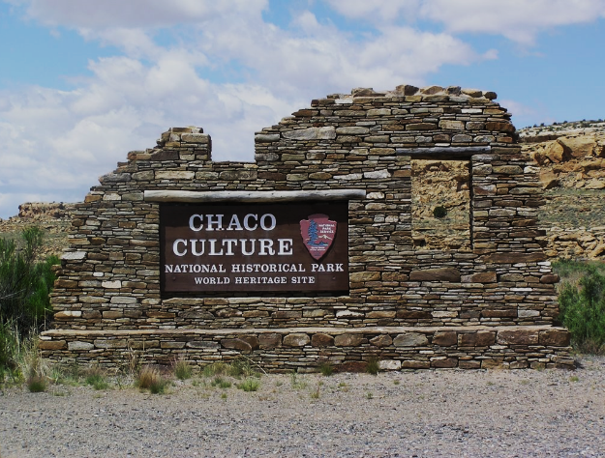
Chaco Culture National Historical Park (NHP)
One of the most significant sites in the world for evidence of ancient Sun-watching
Chaco was a pioneer among National Parks for its consultations with affiliated “tribes” in the 4-corners region, including Navajo, Apache, Hopi, Zuni, and other Ancestral Puebloan tribes such as Acoma and Laguna.
Chaco culture is a ready topic of “cultural relevance” to the descendants of Ancestral Puebloan people and other Southwest Indians in the 4-corners region. Chaco Canyon is one of the most significant sites in the world for evidence of ancient Sun-watching.
The Ancient & Modern Sun-watching theme portrays NASA’s exploration of the Sun as a natural extension of humanity’s long-lived dedication to observing the Sun’s rhythms and mysteries.
Chaco is a World Heritage Site and an International Dark Sky Park.
PUNCH Outreach Plan – Self Directed Summary Overview
cherilynn.morrow@gmail.com
Dr. Cherilynn Morrow 8 April 2021
31
Notes:
http://earthsky.org/science-wire/new-mexican-skies-protected-with-dark-sky-park-designation

Slide 32
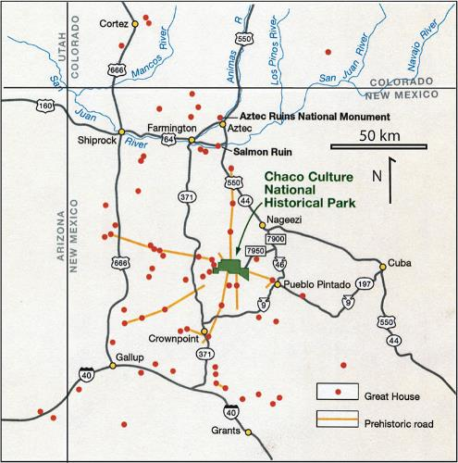
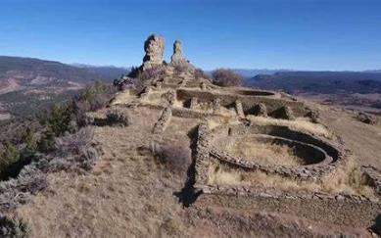
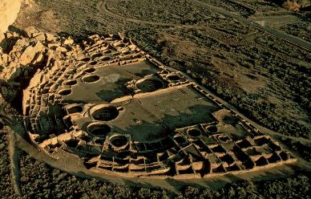
A millennium ago, Chaco Canyon was the hub of a vast cultural network in the 4-Corners region
CHIMNEY ROCK
The twin pillars of Chimney Rock as viewed from the remains of an ancient building with Chacoan masonry and design features. This Chaco “outlier” is in southern Colorado, about 100 miles northeast of Chaco Canyon.
For a 3-year period every 18.6 years, the Moon can rise between the two pillars. The next opportunities to view this occur in the years 2023-2026.
The aerial photo of Pueblo Bonito in Chaco Canyon reveals its half-moon shape. Bonito includes more than 600 rooms and featured walls 4-5 stories tall. It is the largest, most-excavated example of the architecture constructed by Ancestral Puebloans over centuries of time throughout the 4-corners region.
Pueblo Bonito is an important reason that Chaco is a World Heritage site.
Archaeologists have several lines of evidence to indicate that about 1000 years ago, Chaco Canyon was the hub of a vast regional network of hundreds of ancient sites with similar architectural features (red dots). The yellow lines depict areas where 30-foot-wide pre-historic roads have been discovered (via aerial photos). These “roads” strengthen the evidence that Chaco Canyon was an important destination and center of ceremonial activity for a large area of the 4-corners region.
PUNCH Outreach Plan – Self Directed Summary Overview
cherilynn.morrow@gmail.com
Dr. Cherilynn Morrow 8 April 2021
32
Notes:
By USGS - http://pubs.usgs.gov/fs/2004/3035/pdf/fs-2004-3035.pdf, Public Domain, https://commons.wikimedia.org/w/index.php?curid=21418041

Slide 33
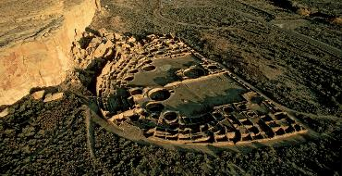
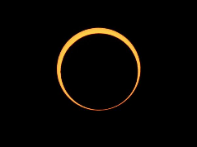
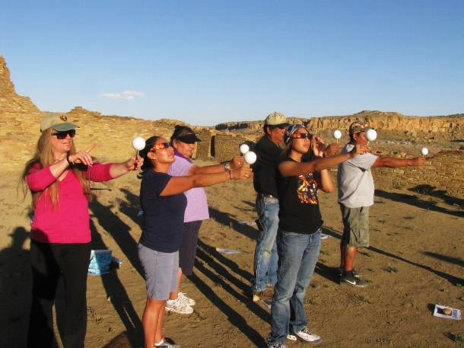
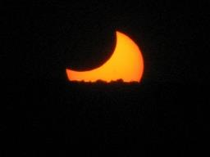
Annular Eclipse Events in Chaco’s Pueblo Bonito
20 May 2012 and 14 October 2023
The yellow star marks the location of the activity depicted below.
Dr. Morrow is using the real setting Sun to teach about the Phases of the Moon to an Apache family before the 2012 annular eclipse “Moon Walk” Program in the east plaza of Pueblo Bonito in Chaco Canyon. The Sun was still partially eclipsed by the Moon as it set below the western horizon.
The PUNCH Outreach plan includes a similar program for the 14 October 2023 Annular Eclipse which will occur in the morning hours and be viewable from the plaza of Pueblo Bonito. This event will include Kinesthetic Astronomy and other embodied learning activities, links to NASA science, and cross-cultural content. The event will be documented for a PUNCH-sponsored planetarium film.
On 20 May 2012, the Sun set partially eclipsed as viewed from Chaco Canyon, NM
Photo by GB Cornucopia
PUNCH Outreach Plan – Self Directed Summary Overview
cherilynn.morrow@gmail.com
Dr. Cherilynn Morrow 8 April 2021
33
Notes:
Photo by GB Cornucopia

Slide 34
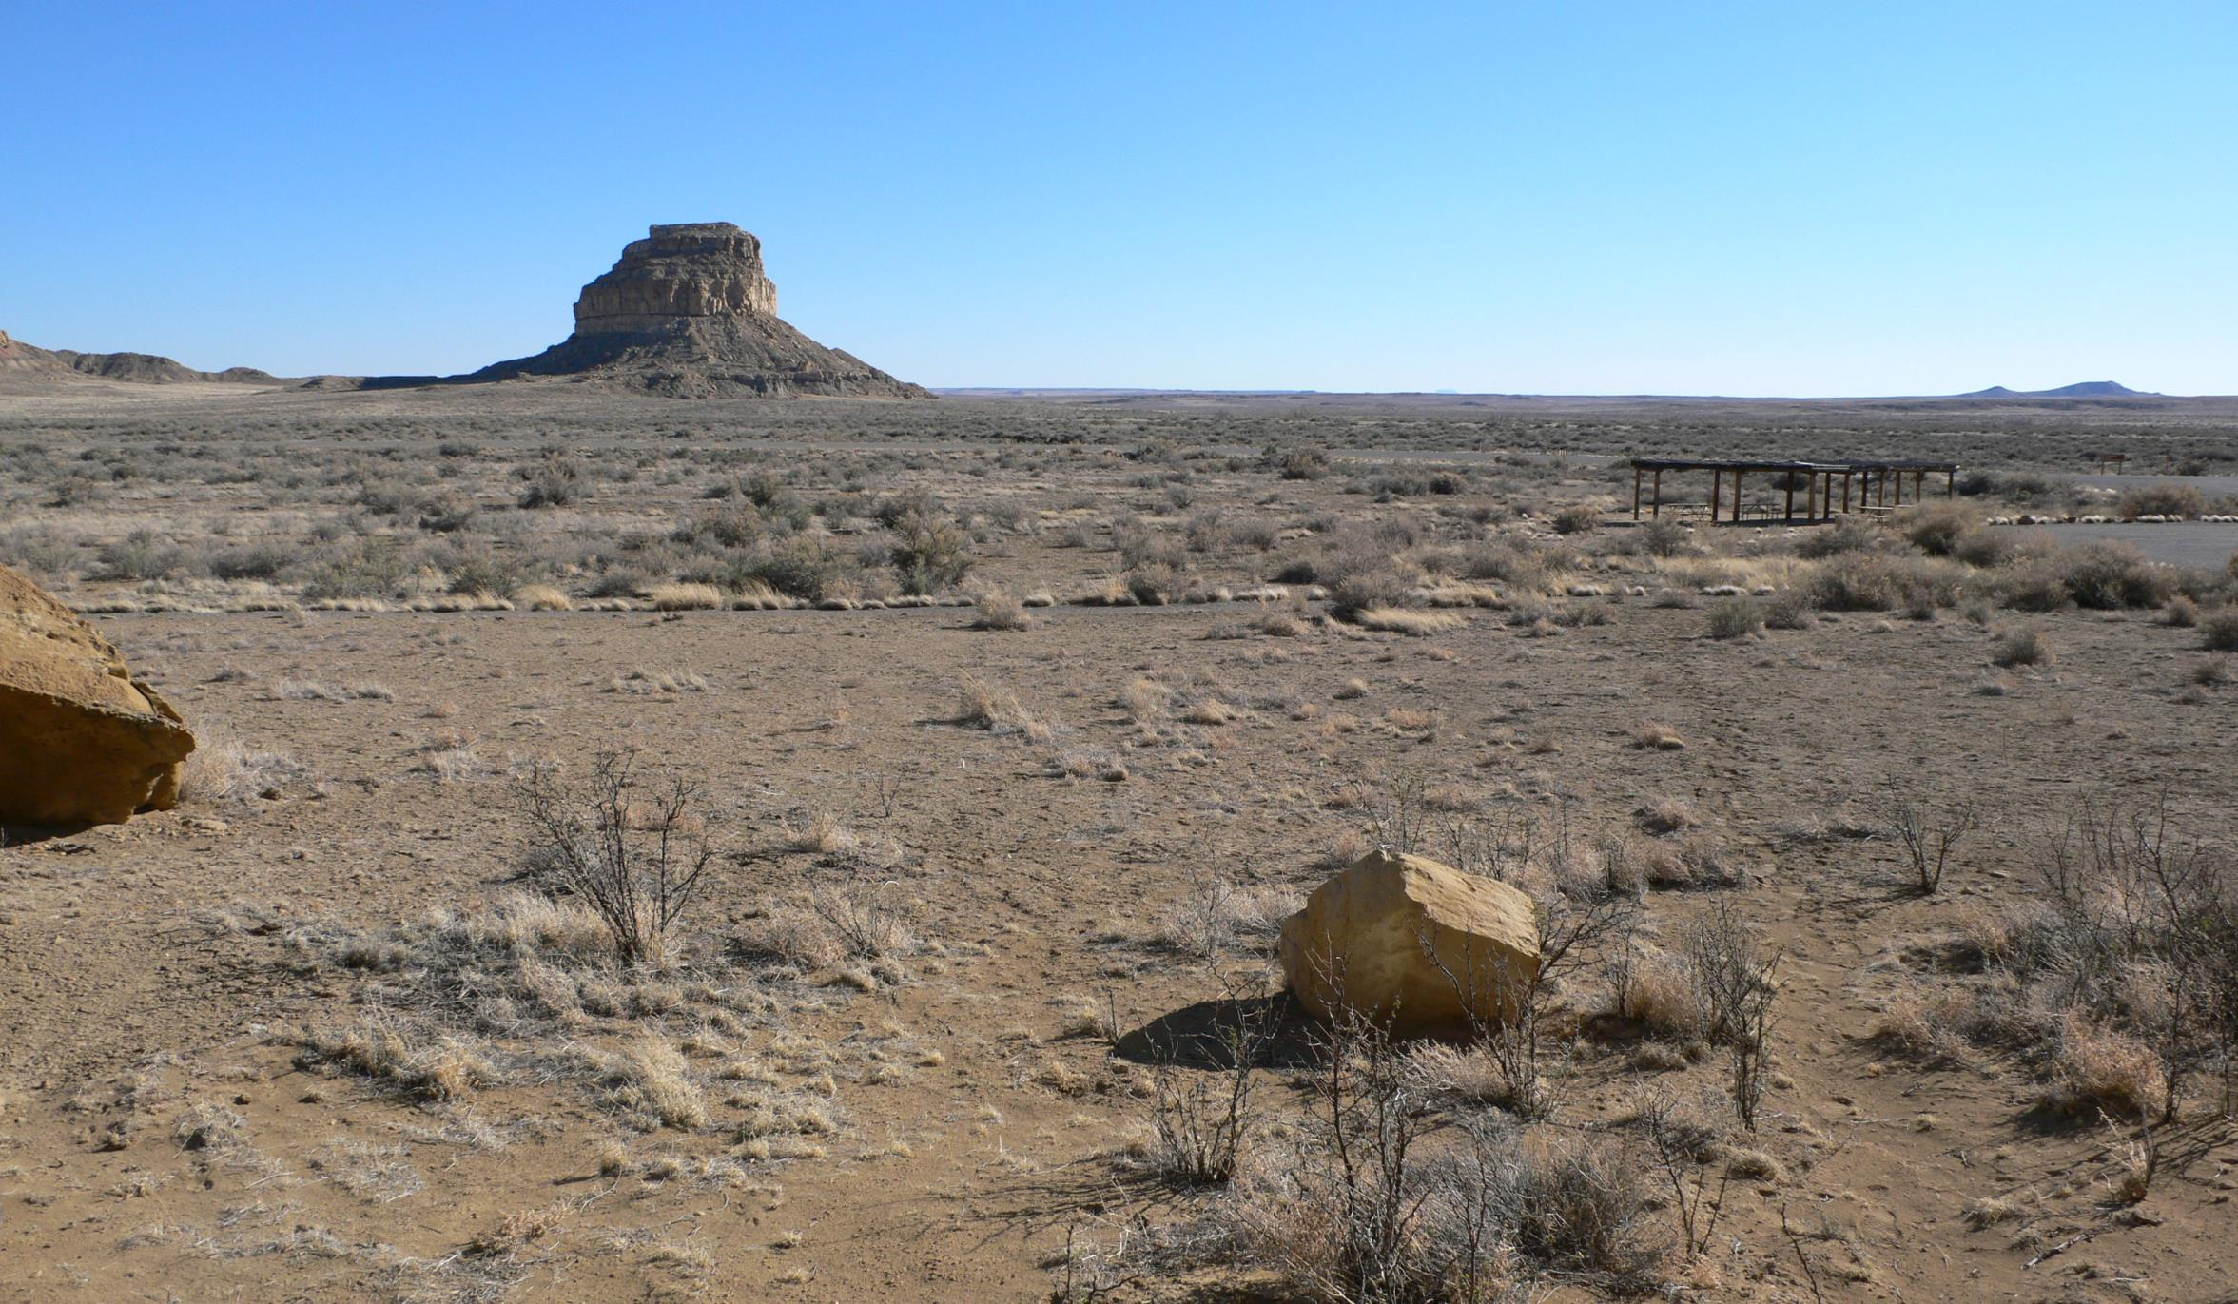
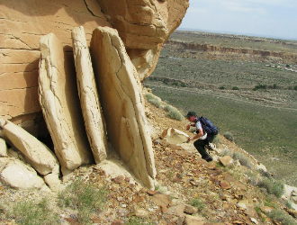
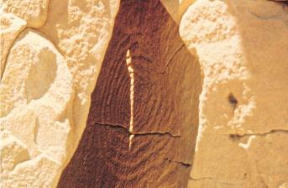
INTRO SLIDE
Presentation by GB Cornucopia – Chaco Ranger
INSERT FAJADA BUTTE & SUN DAGGER SLIDE
Photo by GB Cornucopia
Fajada Butte is the signature geographical feature of Chaco Canyon, located in the remote, high desert of northwestern New Mexico.
The red arrow points to the location of the renowned “Sun Dagger” site. This famous ancient solar observatory atop the Butte is composed of three slabs of rock plus spiral petroglyphs on the rock wall behind the slabs.
The midday Sun shines through the gaps in the slabs to create lighting effects on the petroglyphs at solstice and equinox times of year.
Before erosion spoiled the effect in the 1980’s, a “dagger” of light used to appear around midday near the time of the summer solstice. Over about 20 minutes, the “dagger” would descend through the center of the spiral petroglyph on the sandstone surface behind the three slabs of rock.
PUNCH C & O Planning #1: C. Morrow
Not for distribution without permission
34
PUNCH C & O Planning #2: C. Morrow
11 May 2020 – Zoom Telecon
PUNCH Outreach Plan – Self Directed Summary Overview
Not for distribution without permission
Dr. Cherilynn Morrow 8 April 2021
cherilynn.morrow@gmail.com
4 May 2020 – Zoom Telecon

Slide 35
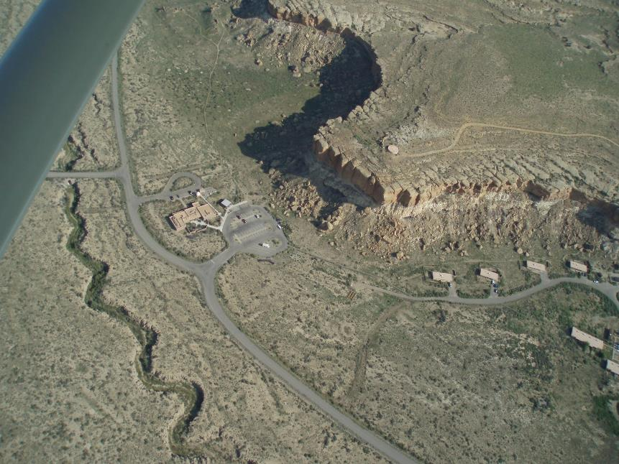
AERIAL VIEW of Chaco Visitor Center area: The Red Circle shows the location of a lesser-known ancient solar observatory that is called 29SJ514 (or “514” for short) in the Chaco archives.
“514” has a clear line of sight to Fajada Butte, which is about 1 km due south. Sun watching at “514” may have been used to help calibrate where to place the pecked spiral on the wall behind the slabs of the Sun Dagger site so that the “dagger” of light would pass through its center to mark the summer solstice.
“514” is also the home of a unique “eclipse” petroglyph that may depict an active solar corona. “514” is thus the primary focus of PUNCH Outreach just as the PUNCH mission is the primary focus among other many other examples of NASA heliophysics missions.
The red circle shows the location of 29SJ514 = the Chaco Sun-watching site that is home to a unique “Eclipse” petroglyph. The white arrow shows the direction to the renowned Fajada Butte, which is ~ 1km due south of this site.
PUNCH Outreach Plan – Self Directed Summary Overview
cherilynn.morrow@gmail.com
Dr. Cherilynn Morrow 8 April 2021
35

Slide 36
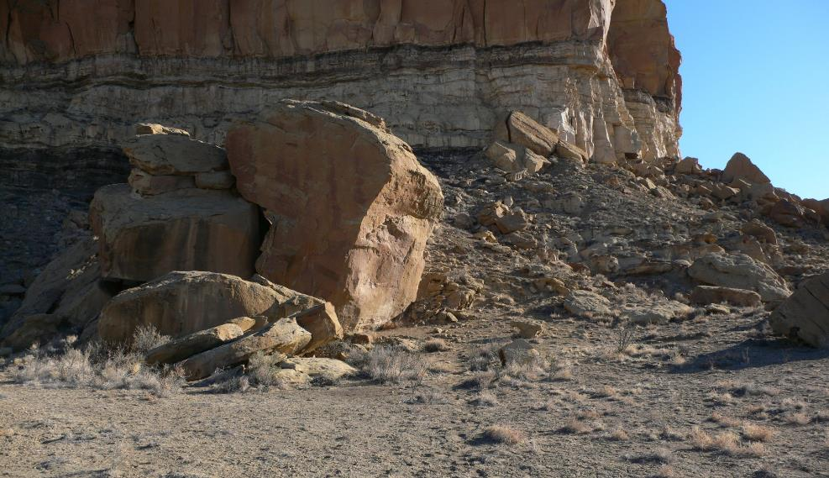
The Three Sun Watching Facets of 29SJ514: EASTERN
an Ancestral Puebloan solar observing site in Chaco Canyon, NM
1. EASTERN Facet: Around the corner, on the facet that faces out toward Triangle Rock, there is a large spiral petroglyph. From that position, looking to the northeast, the sunrise appears to “glide” up the left (north) side of the triangle about half-a-month before the Summer Solstice (see subsequent slides). Cultural astronomers call this a “predictive marker” on the horizon. On the actual summer solstice, the sunrise appears in a small notch further north (to the left) of Triangle Rock. This is its northernmost position over the course of the year. Six months later, at the winter solstice, the Sun will appear to rise at a position much farther south (to the right, out of the field of view of this image).
Triangle Rock
Sunrise on or about
5-6 June
PUNCH Outreach Plan – Self Directed Summary Overview
cherilynn.morrow@gmail.com
Dr. Cherilynn Morrow 8 April 2021
36

Slide 37
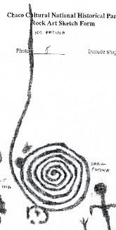
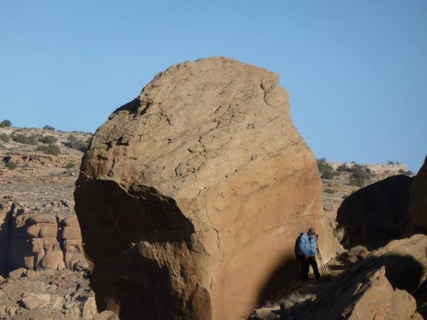
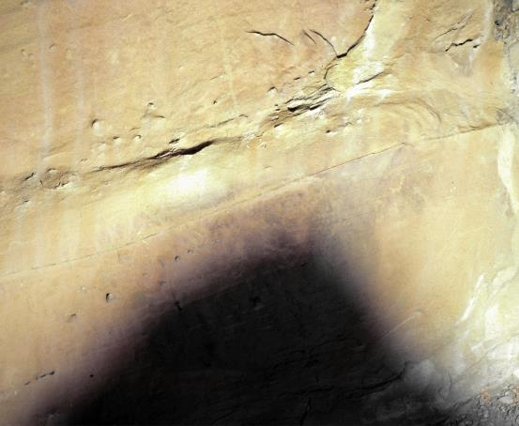
The Three Sun Watching Facets of 29SJ514: EASTERN
an Ancestral Puebloan solar observing site in Chaco Canyon, NM
This pecked line extends upward
from the outside turn of the spiral.
43 cm
The photographer is NOT leaning on the rock which would be a serious violation of Park rules and regulations. He is standing in front of the spiral petroglyph on the eastern facet of 29SJ514, facing out toward Triangle Rock whose shadow is apparent on the rock face behind him. Such access requires special permits from the Park and is not open to the general public.
The red dot marks the center of the spiral petroglyph that is pecked into the rock. The turns of the spiral are centered in the grey circle.The shadow of Triangle Rock interacts with the spiral during sunrises within the Moon of the summer solstice. The shadow interaction is not yet fully documented. The PUNCH Outreach plan includes this documentation plus reflectance transmission imaging (RTI) of the petroglyph that can be used to create a 3-D printable tactile object.
PUNCH Outreach Plan – Self Directed Summary Overview
cherilynn.morrow@gmail.com
Dr. Cherilynn Morrow 8 April 2021
37

Slide 38
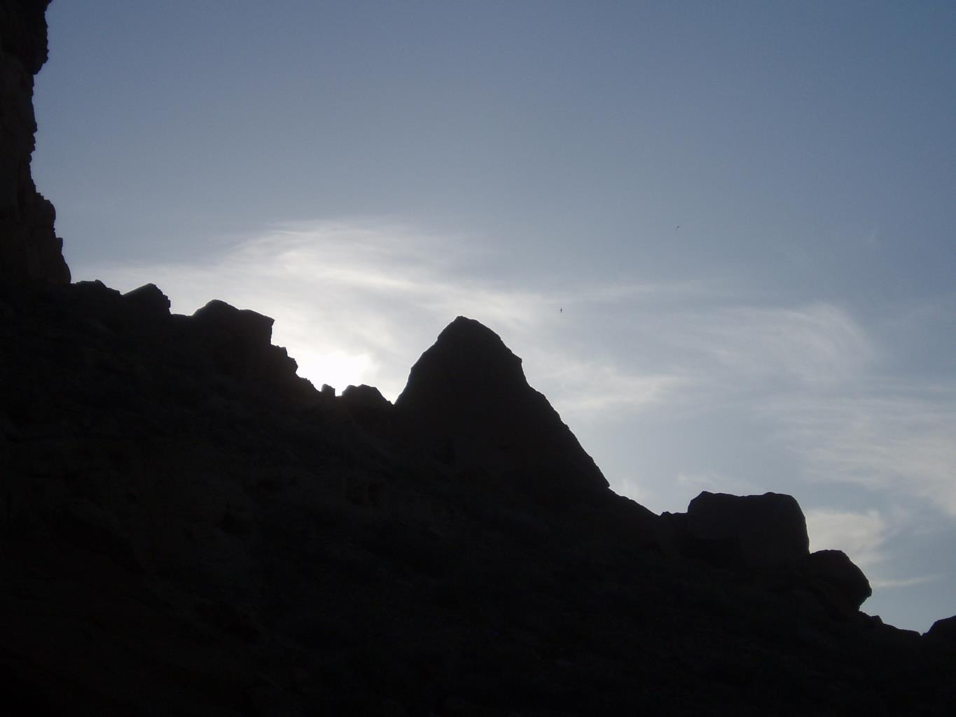
Triangle Rock prior to sunrise.
This rock is located about 68.5 meters (~225 ft) upslope to the northeast from the spiral petroglyph
PUNCH Outreach Plan – Self Directed Summary Overview
cherilynn.morrow@gmail.com
Dr. Cherilynn Morrow 8 April 2021
38

Slide 39
About half-a-month prior and after the Summer solstice (4-6 June & 5-7 July), the Sun appears to rise in the notch on the northern side of Triangle Rock.
This filtered photo was made on 5 June 2008. Click forward three times to see the rising Sun appear to “roll” up the side of the rock.
PUNCH Outreach Plan – Self Directed Summary Overview
cherilynn.morrow@gmail.com
Dr. Cherilynn Morrow 8 April 2021
39

Slide 40
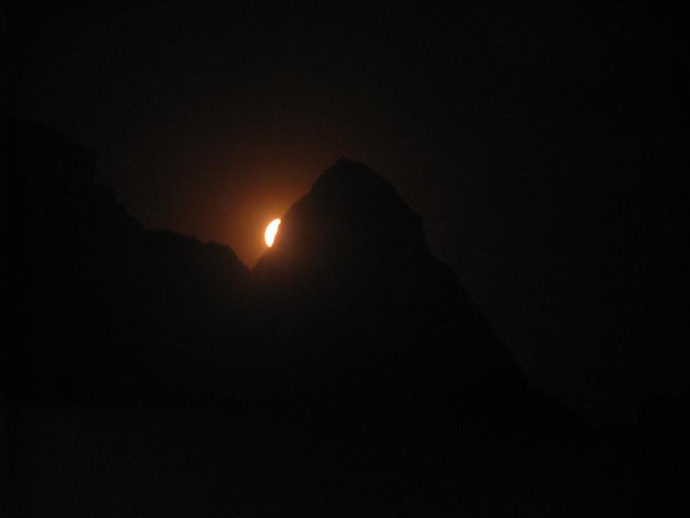
PUNCH Outreach Plan – Self Directed Summary Overview
cherilynn.morrow@gmail.com
Dr. Cherilynn Morrow 8 April 2021
40

Slide 41
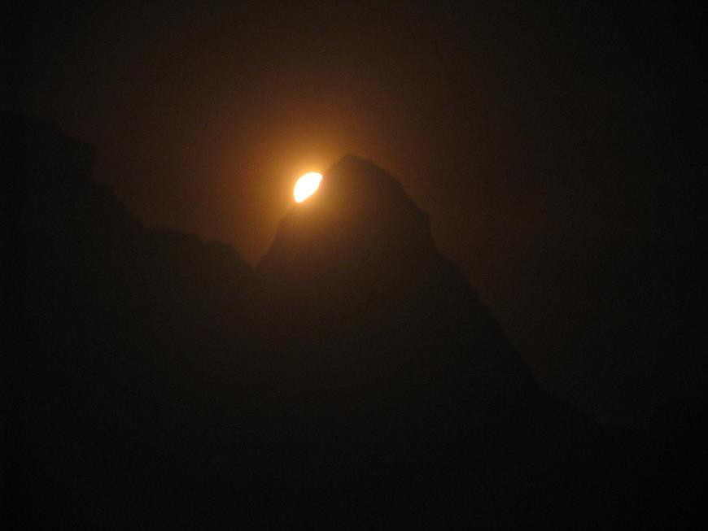
PUNCH Outreach Plan – Self Directed Summary Overview
cherilynn.morrow@gmail.com
Dr. Cherilynn Morrow 8 April 2021
41

Slide 42
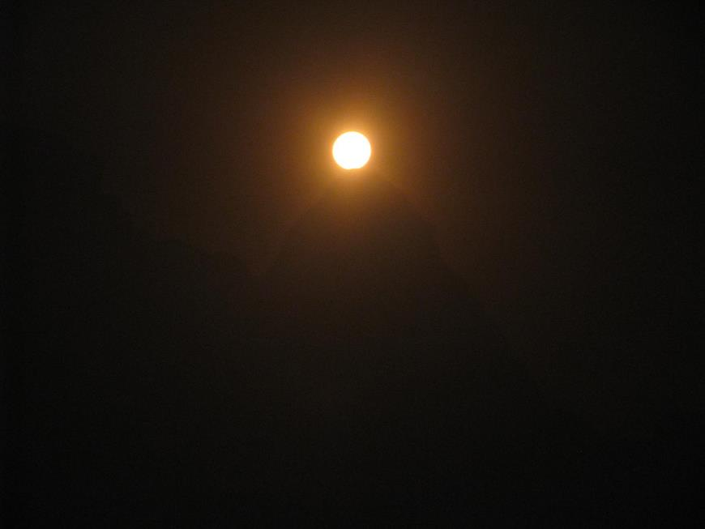
5 June 2008
The Sun takes about 11 minutes to “roll” from first appearance at the base to the top of Triangle Rock.
These filtered images are samples from a set of 12 photos made with uneven cadence during this time.
PUNCH Outreach supports acquiring high-resolution time-lapse photography of this solar event and creating a tactile representation of it.
PUNCH Outreach Plan – Self Directed Summary Overview
cherilynn.morrow@gmail.com
Dr. Cherilynn Morrow 8 April 2021
42

Slide 43
INTRO SLIDE
Panorama from 514: Triangle Rock (northeast) to Fajada Butte (south)
Triangle Rock
Fajada Butte
PUNCH Outreach Plan – Self Directed Summary Overview
cherilynn.morrow@gmail.com
Dr. Cherilynn Morrow 8 April 2021
43

Slide 44
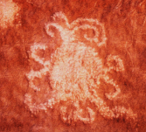
The Three Sun Watching Facets of 29SJ514: SOUTHERN
an Ancestral Puebloan solar observing site in Chaco Canyon, NM
1. EASTERN Facet: Around the corner, on the facet that faces out toward Triangle Rock, there is a large spiral petroglyph. From that position, looking to the northeast, the sunrise appears to “glide” up the left (north) side of the triangle about half-a-month before the Summer Solstice. Cultural astronomers call this a “predictive marker” on the horizon. On the summer solstice, the sunrise appears in a small notch further north (to the left) of triangle rock.
Triangle Rock
2. SOUTHERN Facet: The “eclipse” petroglyph is pecked into the rock on this facet. It may be the first ever recording of an active solar corona in an enduring medium and is certainly prior to the 1860 hand drawings of European observers.
The petroglyph provides a conceptual portal between Ancient and NASA Sun-watching. The Chacoans observed a total solar eclipse in 1097 during a time of high solar activity (solar maximum estimated to be in 1098). PUNCH and other NASA missions will also observe the corona at a time of high solar activity (solar maximum predicted during 2023-2026).
PUNCH Outreach Plan – Self Directed Summary Overview
cherilynn.morrow@gmail.com
Dr. Cherilynn Morrow 8 April 2021
44

Slide 45
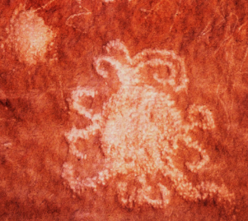
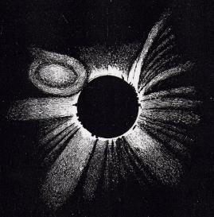
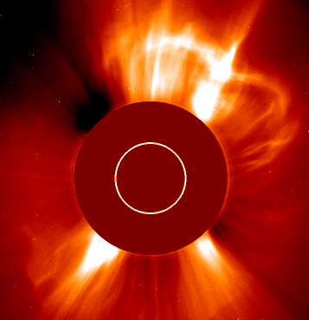
The Chaco Petroglyph is the Conceptual Portal for the
Ancient & Modern Sun Watching Theme of PUNCH Outreach
*CME = Coronal Mass Ejection = a type of solar storm that disrupts the solar corona and surrounding heliosphere
Human renderings of an active solar corona through time?: Ancient rock art, Hand drawing, and a NASA spacecraft image. PUNCH Outreach will leverage the connection among:
the Chacoan observation of the 1097 total solar eclipse at a time of high solar activity (solar maximum ~1098)
the opportunity modern people have to observe the 2024 total solar eclipse, also at a time of high solar activity (solar max ~ 2023-2026)
the milestones and discoveries of NASA heliophysics missions that are observing the corona during solar maximum
Ancestral Puebloan petroglyph in Chaco Canyon, interpreted to depict the 1097 total solar eclipse. Are the curlicues due to a CME*? Solar maximum~1098.
An 1860 drawing of a total solar eclipse from Spain (G. Tempel). Distortions of the striations were rendered in other drawings. A CME*?
2005 coronagraph image from the NASA SOHO spacecraft with a CME* in progress. The white circle defines the solar disk.
PUNCH Outreach involves collaborating with our Native American partners and the NASA Heliophysics Communications group to update the content of this video. This amends the Western narrative on the history of eclipse observations in a cross-culturally appropriate manner.
PUNCH Outreach Plan – Self Directed Summary Overview
cherilynn.morrow@gmail.com
Dr. Cherilynn Morrow 8 April 2021
45

Slide 46
Why should a Hopi care about Heliophysics?
As an example of the importance of cultural tie-ins for science learning, during conceptual development of the PUNCH outreach plan our consultant Mr. Phillip Tuwaletstiwa (a member of the Hopi tribe) asked questions like:
“Why should a Hopi care about Heliophysics?”
“How are Coronal Mass Ejections (CMEs) relevant to Ancestral Puebloan people?”
The “eclipse” petroglyph provides a link and demonstrates relevance. According to cultural astronomer and CU professor emeritus, Dr. McKim Malville, it is possible that Chacoan ancestors of modern Hopi, Zuni (and other Puebloan peoples) may have been the first to record (in an enduring medium) the likeness of an active solar corona observed during a total solar eclipse.
PUNCH Outreach activates this connection to the ancient Chacoans to establish cultural relevance for modern young and adult learners and to spark interest in heliophysics as a gateway to STEM learning.
PUNCH Outreach intends to work with our Native American collaborators to set the science-historical record straight, establishing a durable connection to STEM fields for a currently underrepresented, cross section of the American population.
This includes inviting names for 29SJ514 in Puebloan languages (named “Piedra del Sol” by Malville et al.) that are more culturally relevant to the contemporary Puebloan people. We will collaborate on this opportunity with Mr. Tuwaletstiwa, Acoma elder Joe Aragon (collaborator), and other cross-cultural consultants for PUNCH Outreach, including youth and educators from Acoma and Laguna Pueblos. The UNESCO International Decade of Indigenous Languages (2022 – 2032) overlaps with the PUNCH Outreach project.
I am interested in the overlap of cultural significance and NASA science learning that is possible, including potential links to the Acoma language revitalization project…
Joe Aragon
STEM Educator (retired), Acoma Pueblo
PUNCH Outreach Cross-cultural consultant
PUNCH Outreach Plan – Self Directed Summary Overview
cherilynn.morrow@gmail.com
Dr. Cherilynn Morrow 8 April 2021
46

Slide 47
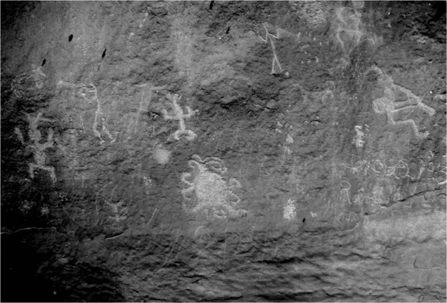
The Three Sun Watching Facets of 29SJ514: SOUTHERN
an Ancestral Puebloan solar observing site in Chaco Canyon, NM
The encircled petroglyph may be a likeness of the 1097 total solar eclipse of the Sun during a time of high solar activity. An independent estimate of the solar maximum during this period is 1098, meaning that solar storms that could curve and distort the corona’s usual radial features would have been more likely to occur. The PUNCH Outreach plan includes creating a 3-D printable tactile object of this petroglyph.
This rock panel received media attention leading up to the 2017 Eclipse (e.g., Scientific American podcast, Smithsonian article, and TV & print news media)d, all due to a University of Colorado press release.
It will be newsworthy again with added twists in companionship with the:
the 2023 annular eclipse in Chaco
the 2024 total eclipse – also at a time of a solar maximum predicted for 2023 - 2026
milestones of NASA missions like PUNCH exploring the corona in this time frame.
This small disk is pecked into the rock face in the same style as the “Sun” petroglyph and may be a representation of Venus – an inner planet that is often visible when the Sun is totally eclipsed.
10 cm
PUNCH Outreach Plan – Self Directed Summary Overview
cherilynn.morrow@gmail.com
Dr. Cherilynn Morrow 8 April 2021
47

Slide 48
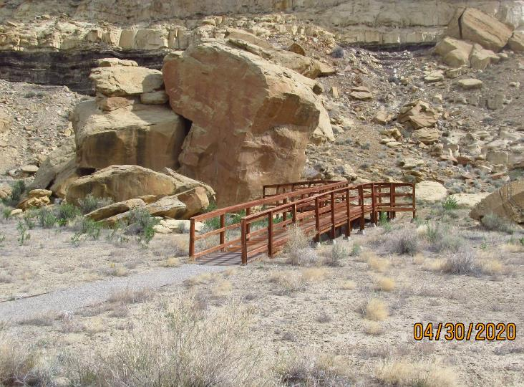
The ramp at 29SJ514 enables participants of ranger-guided programs to view the rock art panel that includes the “eclipse” petroglyph.
There is no access to the Sun-watching “stations” on the eastern and western facets of the site, both of which are always off-limits to the public.
Because of the site’s proximity to the Visitor Center, it is often included on the agenda for visiting youth groups and during Chaco events associated with Equinox and Solstice times of year.
The PUNCH Outreach plan includes seeking permissions for the collection of leading-edge photographic resources that allow a 3-D digital re-construction of the entire site. This documentation of cultural heritage is valuable for:
our cultural partners and their communities;
the Chaco research archive,
creating digital interactive experiences and lessons (including self-directed training for Chaco interpreters), and
developing planetarium animations.
The PUNCH Outreach plan includes sponsoring Chaco visits for Girl Scouts in the surrounding rural areas and for students & educators from the Acoma and Laguna Pueblos, both of which have strong ancestral ties to Chaco.
There is now a ramp for ranger-guided programs at 29SJ514.
PUNCH Outreach Plan – Self Directed Summary Overview
cherilynn.morrow@gmail.com
Dr. Cherilynn Morrow 8 April 2021
48

Slide 49
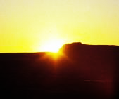
The Three Sun Watching Facets of 29SJ514: WESTERN
an Ancestral Puebloan solar observing site in Chaco Canyon, NM
1. EASTERN Facet: Around the corner, on the facet that faces out toward Triangle Rock, there is a large spiral petroglyph. From that position, looking to the northeast, the sunrise appears to “glide” up the left (north) side of the triangle about half-a-month before the Summer Solstice. Cultural astronomers call this a “predictive marker” on the horizon. On the summer solstice, the sunrise appears in a small notch further north (to the left) of triangle rock.
Triangle Rock
2. SOUTHERN Facet: The “Eclipse” petroglyph is on this facet. It may be the first ever recording of an active solar corona in an enduring medium.
The petroglyph provides a conceptual portal between Ancient and NASA Sun-watching. The Chacoans observed a total solar eclipse in 1097 during a time of high solar activity. NASA missions will also observe the corona during solar maximum.
3. WESTERN Facet: Inside this natural alcove there is an oval grinding area, a small basin pecked into the rock, and a “reptile” petroglyph. Looking to the southwest from inside this cozy place, the sunset interacts with a step-like horizon feature about half-a-month before the Winter Solstice.
PUNCH Outreach Plan – Self Directed Summary Overview
cherilynn.morrow@gmail.com
Dr. Cherilynn Morrow 8 April 2021
49

Slide 50
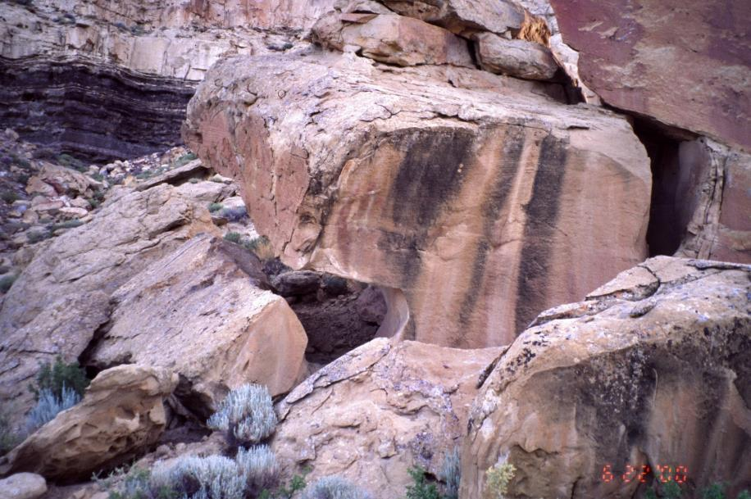
The Three Sun Watching Facets of 29SJ514: WESTERN
A closer view of the alcove on the western facet of 29SJ514
A petroglyph of a “reptile” is around this corner on the rock surface facing inside the alcove
PUNCH Outreach Plan – Self Directed Summary Overview
cherilynn.morrow@gmail.com
Dr. Cherilynn Morrow 8 April 2021
50

Slide 51
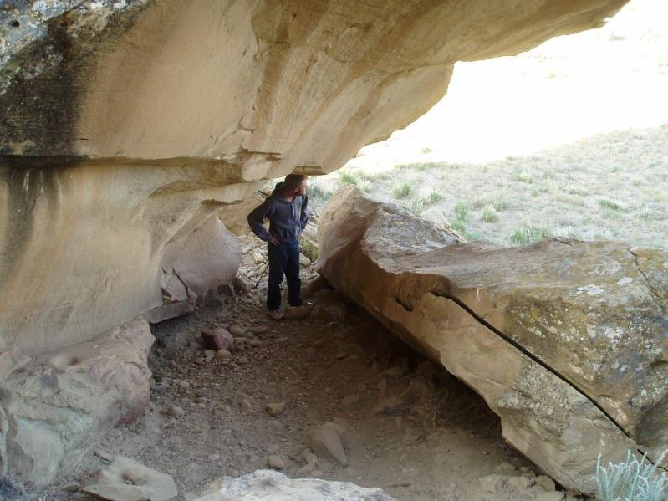
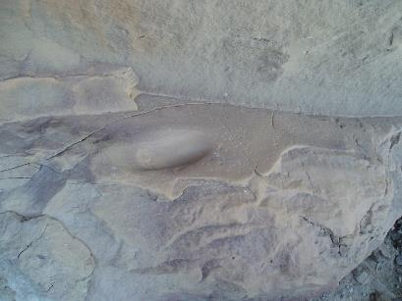
The Three Sun Watching Facets of 29SJ514: WESTERN
Inside the alcove on the western facet of 29SJ514
Oval grinding areas and round basins pecked into the rock are sometimes associated with Sun-watching sites in the 4-Corners region.
Sight line to the sunset interaction with a winter solstice predictive marker on the southwestern horizon
Close up of the oval grinding area circled in red (at right)
Arrow extends from a small, round basin pecked into the rock
PUNCH Outreach Plan – Self Directed Summary Overview
cherilynn.morrow@gmail.com
Dr. Cherilynn Morrow 8 April 2021
51

Slide 52
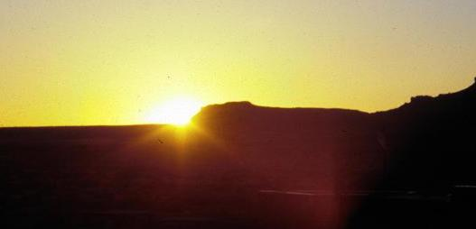
From the alcove on the western facet of 29SJ514 on or about 7 December
From the alcove on the western facet of “514” the sunset interacts with a “step-like” horizon feature to the southwest about a half-month before the Winter Solstice (on or about 7 December).
On the actual solstice the Sun appears to set further to the left (south) on the flat and featureless horizon. This is the southernmost sunset during the year.
The sunset returns to the “step” about a half-month after the Winter solstice in early January in keeping with the natural cycle of the seasons.
The sunset position continues northward for six months until the northernmost sunset occurs during summer solstice.
Zoomed and filtered
PUNCH Outreach Plan – Self Directed Summary Overview
cherilynn.morrow@gmail.com
Dr. Cherilynn Morrow 8 April 2021
52

Slide 53
Why I Support the Punch Outreach Effort
As a member of the Hopi Tribe, I strongly support the PUNCH Outreach effort.
In 1984, I became involved in Anna Sofaer’s Solstice Project to document and publicize the Sun Dagger Site on Fajada Butte in Chaco Canyon. My reasons today, in supporting Dr. Morrow and her colleagues, run parallel to my earlier commitment to the Solstice Project: I want Native People to know their ancestors were deeply committed to understanding the science of the Sun’s movements and to using that knowledge to bring order to their lives.
Native People today avidly follow the Sun’s daily, monthly, and yearly passages. The Sun tells us when to plant. It sets our ceremonial cycle. We offer prayers at sunrise. We name the newborn, holding the baby to see the Sun showing its forehead on the horizon. We bury the dead facing the Western Sun. We know, as the Sun approaches its Winter House, it is the “quiet time,” stopping noisy activities, a time to tell stories. Following the Sun’s [seasonal] cycle is a continuous, essential, and integral part of the daily lives for all of the Southwestern Indians.
The sun was a mysterious and powerful force to the Ancestors. Today, our scientific knowledge of the Sun has made quantum leaps in helping us understand our stellar neighbor. In time, what we know today will seem basic to what we will know in the future.
I applaud the work of the solar scientists for many reasons, but in particular because I know their work will augment and enhance Native Traditional Knowledge. It will expand and complement the mystery explored by our Puebloan Ancestors.
Thank you,
Phillip Tuwaletstiwa
Galisteo, NM
24 May 2020
PUNCH Outreach Plan – Self Directed Summary Overview
cherilynn.morrow@gmail.com
Dr. Cherilynn Morrow 8 April 2021
53

Slide 54
Eight Guiding Principles for the PUNCH Outreach Plan
Engaging outreach expertise in collaboration with mission leadership
Synergizing the Science, Outreach, and Communication Teams (e.g., on website)
Coordinating & synergizing with allied NASA groups & missions
Enacting a thematic approach to broaden participation
Aligning mission attributes with outreach participants, partners, and products
Leveraging strengths & partnerships among multiple institutions
Learning from those we intend to benefit from the start
Using evidence-based practices & integrating evaluative processes
Eight KEY principles guide the development and implementation of the PUNCH Outreach plan.
PUNCH Outreach Plan – Self Directed Summary Overview
cherilynn.morrow@gmail.com
Dr. Cherilynn Morrow 8 April 2021
54

Slide 55
The choices of outreach participants, partners, and products for the PUNCH Outreach Plan have been strongly influenced by the attributes of the PUNCH mission: science, data, and people as well as the strengths and interests of the Outreach & Communications Lead (OCL) and the Principal Investigator.
PUNCH Outreach Plan – Self Directed Summary Overview
cherilynn.morrow@gmail.com
Dr. Cherilynn Morrow 8 April 2021
55

Slide 56
Eight Guiding Principles for the PUNCH Outreach Plan
Engaging outreach expertise in collaboration with mission leadership
Synergizing the Science, Outreach, and Communication Teams (e.g., on website)
Coordinating & synergizing with allied NASA groups & missions
Enacting a thematic approach to broaden participation
Aligning mission attributes with outreach participants, partners, and products
Leveraging strengths & partnerships among multiple institutions
Learning from those we intend to benefit from the start
Using evidence-based practices & integrating evaluative processes
Eight KEY principles guide the development and implementation of the PUNCH Outreach plan.
PUNCH Outreach Plan – Self Directed Summary Overview
cherilynn.morrow@gmail.com
Dr. Cherilynn Morrow 8 April 2021
56

Slide 57
Clark Planetarium
The PUNCH Outreach Core Consortium
[POCC, pronounced “pock”]
SWRI + Five Outstanding Outreach institutions in the 4-Corners states of the US Southwest
Fiske Planetarium &
SWRI – Space Science both in Boulder, CO
Lowell Observatory
PUNCH partners with the POCC (“pock”) institutions to leverage its people, data, milestones, and discoveries for high-impact public engagement.
The POCC institutions (green boxes) are highly experienced in convening public events. Our partners have a combined annual visitorship of about 750,000. Of these, over 225,000 participate in a full-dome planetarium experience during their visit.
The red circle shows the location of Chaco Culture National Historical Park (NHP).
Our evaluator is from the Planetary Science Institute (blue box).
NM Museum of Natural History & Science NMMNHS
Alamogordo
NM Museum of
Space History & the NM
School for Blind & Visually Impaired
Planetary Science Institute (Our Evaluator)
PUNCH Outreach Plan – Self Directed Summary Overview
cherilynn.morrow@gmail.com
Dr. Cherilynn Morrow 8 April 2021
57

Slide 58
POCC Institutions – Relevant Strengths & Assets Summary (from 2020 Survey data & team meetings)
NEW MEXICO
MNHS, MSH, SBVI
(Albuquerque/Alamogordo)
UTAH
Clark Planetarium
(Salt Lake City)
COLORADO
Southwest Research Inst.
(SwRI - Boulder)
COLORADO
Fiske Planetarium
(CU Boulder)
ARIZONA
Lowell - NAAOP
(Flagstaff)
MNHS: The Museum of Natural History and Science (MNHS) is host of the only Sun Dagger exhibit;
MNHS: Strong relationships with Native American (Acoma & Laguna) and Latinx communities (NHCC).
MNHS: Strong experience supporting Girl Scouts
MNHS: Experienced Meeting/conference hosts
MSH: The Museum of Space History (MSH) has strong record of building replicable spacecraft models for educational use
MSH: strong connection to J. Killebrew – the science teacher at the NM School for the Blind and Visually Impaired (SBVI).
MNHS & MSH: Portable planetarium use
Many years of experience in dome show development & market research
Extensive experience in field photography and asset planning for full-dome film development (D. Johnson)
Strong duo of leading-edge animators on staff
Renowned capacity for development of on-line and in-house digital interactives.
Many years of staff experience applying Kinesthetic Astronomy (KA) for state-approved and state-sponsored teacher events all over Utah.
Access to historically marginalized populations in Southeastern Utah
Southwest Research Institute (SwRI) is home to the PUNCH mission and PI = Dr. Craig DeForest
PUNCH Outreach lead is SwRI Consultant, Cherilynn Morrow, who is a PhD solar physicist well linked to the heliophysics community
While at NASA HQ, Morrow was lead author on several white papers and presentations on “best-practices” in integrating outreach into NASA space science missions
Creator of Kinesthetic Astronomy – an embodied approach to teaching & learning that infuses all elements of the PUNCH Outreach plan.
Cross-cultural adaptation of KA for teachers of Navajo learners
> 10 years experience as a volunteer interpreter & research assistant for Chaco Sun-Watching sites
Designer/Facilitator of STEAM training for museum, science center, and planetarium staff nationwide.
Fiske is based at U. Colorado with a strong undergraduate workforce and routine use of evaluation and astronomy education research
Director (John Keller) teaches course in Cultural Astronomy; use of Kinesthetic Astronomy (KA) for many years
Strong production experience in NASA-funded film development; photography & videography; and prior Chaco fieldwork & dome assets.
Strong education staff with ties to Social & Emotional Learning, Spanish language, and commitment to diversity, equity, and inclusion (DEI).
Pursuit of tactile object development and application
Strong commitment to integrating the arts in STEM
Home to award-winning program of Native American outreach (Native American Astronomy Outreach Program – NAAOP). NAAOP partners scientists & teachers of Native children for a year of classroom visits, star parties, and other events.
Strong relationships with Native American consultants.
Director (Jeff Hall) interest in PUNCH and expertise in solar & stellar activity. Potential participant and recruiter of other solar scientists as NAAOP partners
Open air observation deck with seasonal sunrise markers – one of several potential venues for using Kinesthetic Astronomy and other PUNCH-sponsored activities.
PUNCH Outreach Plan – Self Directed Summary Overview
cherilynn.morrow@gmail.com
Dr. Cherilynn Morrow 8 April 2021
58

Slide 59
The POCC institutions enact a “Stone Soup” Collaborative Model to maximize benefits.
PUNCH Outreach pools and leverages the strengths of POCC institutions (circles) in a “stone soup” collaborative model.
Each organization leads the Consortium on developing the products, events, or partnerships indicated in the colored boxes.
Every institution benefits from the combined resources (the broader, gray outward arrows) which enables them to build new capacities to engage diverse learners.
The model fosters more overall productivity and beneficial impact than a single institution could have with the same funds and period of performance.
PUNCH Outreach enacts two essential elaborations of the stone soup model:
all POCC institutions have opportunities to influence the development of every other product, event, or relationship besides ones for which they play a leadership role; and
PUNCH Outreach resources are available to everyone outside the POCC collaborative via our connections with dissemination partners (see slide on PUNCH Outreach and Communications Alliance (POCA).
Fiske
Live Interaction
Planetarium Shows
3D Tactile Objects
NM MNHS
NM MSH
NM SBVI
PUNCH Outreach
“Stone Soup" Collaborative
Native & Latinx Partners
Community STEAM Events
Girl Scout Patch Events
Solar Observing for the Visually Impaired (SOVI)
Spacecraft Models
Lowell (NAAOP)
Clark
Activity adaptation for the Native American Astronomy Outreach Program (NAAOP)
SwRI
Field Photography
Fly-around Animations
Digital Interactive Lessons
Chaco Resources
Kinesthetic Astronomy
Multi-sensory Activities
PUNCH Outreach Plan – Self Directed Summary Overview
cherilynn.morrow@gmail.com
Dr. Cherilynn Morrow 8 April 2021
59
Notes:
By USGS - http://pubs.usgs.gov/fs/2004/3035/pdf/fs-2004-3035.pdf, Public Domain, https://commons.wikimedia.org/w/index.php?curid=21418041

Slide 60
PUNCH Outreach Core Constortium (POCC) – Core Values
All PUNCH Outreach Core Consortium (POCC) members are committed to…
PROFESSIONAL DEVELOPMENT as Individuals and as Institutions [ …enhancing capacities in: 1. NASA heliophysics content & pedagogical content knowledge; 2. product & event development with evaluation; 3. multi-modal (e.g., embodied and tactile) approaches to participant-centered engagement; 4. broadening participation (BPiP = Broadening Participation in Planetariums)]
UNDERSERVED/UNDERREPRESENTED Outreach […developing cross-cultural competence with our Ancient & Modern Sun-watching theme; skillfully collaborating with historically marginalized populations we intend to benefit and learn from]
NATIVE & WESTERN SCIENCE Dialogue […participating in this dialogue and learning how it can influence our processes & products to make them more valuable & impactful to people of ALL cultures (e.g., enacting a more holistic, multi-sensory, arts & language-integrated/STEAM approach to outreach)]
COLLABORATION & COMMUNICATION Best Practices […enacting our Stone Soup model to leverage strengths & assets among partners; providing valuable field testing & feedback for one other; practicing RIKO = Respect, Integrity/Inquiry, Kindness, and Openness with each other, our scientists, our partners, and our participants to cultivate enduring relationships]
HELIOPHYSICS Thematic Approach […illuminating the novel contributions of the PUNCH mission & in the broader context of relationships to other NASA heliophysics missions and to other scientific, cultural, historic, and artistic explorations of our star, the Sun]
PUNCH Outreach Plan – Self Directed Summary Overview
cherilynn.morrow@gmail.com
Dr. Cherilynn Morrow 8 April 2021
60

Slide 61
PUNCH Outreach Core Consortium (POCC) – What is BPiP?
All POCC Institutions are committed to our Broadening Participation in Planetariums (BPiP) initiative to help ensure that PUNCH Outreach events enhance opportunities for historically marginalized youth to become interested in science and more confident about considering STEM-related careers. BPiP involves:
A 2-day workshop at each POCC institution facilitated in Year 1 or 2 of the project by our Diversity Consultant and Evaluator to examine current and past practices and ideas for new strategies on broadening participation in programming related to the PUNCH Outreach plan
Institutional Action Plan for Broadening Participation in the context of PUNCH Outreach activities
Annual follow-ups
One strategy for BPiP success is to conduct front-end assessment of needs and opportunities with representatives of the populations we intend to benefit. This means consulting with Girl Scouts, B/VI learners, and Native & Hispanic youth about products and events intended to engage them and their families.
PUNCH Outreach Plan – Self Directed Summary Overview
cherilynn.morrow@gmail.com
Dr. Cherilynn Morrow 8 April 2021
61

Slide 62
Distinguishing the POCC and POCA
The PUNCH Outreach & Communications Alliance (POCA**)
To ensure maximum benefit, we have also formed a broader collaborative alliance. The “PUNCH Outreach & Communications Alliance” (POCA**) includes the funded core consortium (POCC) and adds a set of advisors, dissemination partners, and liaisons to represent NASA and other relevant organizations on a no-exchange-of-funds basis. The layer added to the POCC to make the POCA contains three new types of colleagues for the overall PUNCH Outreach team, including:
1) Colleagues doing complementary work in heliophysics communications at SwRI and at NASA GSFC with whom we continue to coordinate and explore synergies of effort.
2) A PI-designated liaison from the heliophysics education group (HEAT), and connections to six other NASA-sponsored programs of relevance to PUNCH Outreach (see the Table on Slide 23).
3) Dissemination partners who assist with national and strategic local dissemination (e.g., the International Planetarium Society, the Astronomical Society of the Pacific, the San Juan College Planetarium – the nearest one to Chaco Canyon and a large Navajo population; Howard B. Owens Planetarium – the nearest one to NASA GSFC which is the workplace of several PUNCH scientists)
The PUNCH-funded POCC executes the core mission of regional outreach in the US Southwest. The POCA helps to radiate the impact of PUNCH Outreach to the nation. The diagram on the next slide depicts these layers of partnership leading from the PUNCH mission to a diverse public.
** “Poca” is a name of Algonquin origin, generally given to a girl, meaning “playful” or “friendly”
PUNCH Outreach Plan – Self Directed Summary Overview
cherilynn.morrow@gmail.com
Dr. Cherilynn Morrow 8 April 2021
62

Slide 63
NASA PUNCH Outreach Plan
PUNCH
Mission Team
PUNCH
Outreach & Communications
Alliance (POCA)
PUNCH Outreach
Core Consortium
(POCC)
30+ Scientists mostly in CO, SW Texas, and MD
High percentage of women in STEM
Associate Investigators interested in Outreach
Student Collaborators interested in Outreach
PI, Project Scientist, Outreach Director in Boulder, CO
Partners and Pathways to the Public: The diagram shows the relationship between POCC & POCA and the layers of partnership leading from the PUNCH mission to a diverse public.
PUNCH Mission Team + SwRI +
5 Planetariums and science centers in 4 states (CO, NM, UT, AZ) +
Key collaborators & consultants
The PUNCH Mission Team +
PUNCH Outreach Core Consortium +
Chaco Culture National Historical Park
Scobee Education Center, San Antonio, TX
Liaisons with relevant NASA programs
Dissemination Partners (ASP, IPS, etc.)
Art & Culture Centers w/STEAM interest
NASA Heliophysics & SwRI Comms
Participating Public
Hundreds of thousands of people served by the combined annual visitorship of Consortium institutions + Chaco + Dissemination Partners
Engagement of historically marginalized populations using the outreach theme of Ancient & Modern Sun watching: Native and Latinx/Hispanic youth & families, Girls in STEM, Blind & Visually Impaired
Emphasis on serving the needs of historically marginalized populations leads to enhanced benefits for all people.
20210421 – v.12D
PUNCH Outreach Plan – Self Directed Summary Overview
cherilynn.morrow@gmail.com
Dr. Cherilynn Morrow 8 April 2021
63

Slide 64
Eight Guiding Principles for the PUNCH Outreach Plan
Engaging outreach expertise in collaboration with mission leadership
Synergizing the Science, Outreach, and Communication Teams (e.g., on website)
Coordinating & synergizing with allied NASA groups & missions
Enacting a thematic approach to broaden participation
Aligning mission attributes with outreach participants, partners, and products
Leveraging strengths & partnerships among multiple institutions
Learning from those we intend to benefit from the start
Using evidence-based practices & integrating evaluative processes
Eight KEY principles guide the development and implementation of the PUNCH Outreach plan.
PUNCH Outreach Plan – Self Directed Summary Overview
cherilynn.morrow@gmail.com
Dr. Cherilynn Morrow 8 April 2021
64

Slide 65
PUNCH Outreach is founded on authentic needs & opportunities
Can a Native American or Latinx youth living in challenging conditions see a way to study NASA science while honoring family and cultural traditions?
Can a blind or visually impaired person “observe” the Sun?
Can a Girl Scout who thought physics was for boys and solving esoteric problems become aware of how physics can relate to a field of societal benefit like heliophysics?
PUNCH Outreach provides opportunities to answer such questions because we include and listen to people from these populations who know what is needed for such outcomes to become a reality.
By collaborating directly with stakeholders who define their own needs and preferences PUNCH Outreach plays a significant role in overcoming barriers to STEM learning and careers.
The next four slides offer a set of quotes from advisors, consultants, and collaborators who have thus far informed the PUNCH Outreach Plan. Some have appeared in previous slides.
PUNCH Outreach is founded on authentic needs & opportunities among the populations we intend to benefit and learn from.
PUNCH Outreach Plan – Self Directed Summary Overview
cherilynn.morrow@gmail.com
Dr. Cherilynn Morrow 8 April 2021
65

Slide 66
Blind & Visually Impaired: The PUNCH Outreach personnel listed below represent diverse cultures and help to ensure that PUNCH outreach efforts are grounded in the needs and opportunities of the marginalized populations we aim to benefit (and learn from). The proposed PUNCH outreach products & events reflect the wisdom and guidance offered by these courageous voices.
Learners | Name of Advisor or Collaborator | Role | Understanding the needs and opportunities for these learners
Blind & Visually Impaired | Jeff Killebrew, Science Teacher, NM School for the Blind & Visually Impaired, Alamogordo, NM | Collaborator | Many B/VI students have an interest in learning about the universe but have not had access to really be a part of that learning. Having an opportunity to participate through tactile and/or auditory means will excite the learners while giving them a sense of belonging and acceptance. Those who are blind are no different than those who are sighted - they just want to belong and to explore without being told that they can't. The more opportunities they have, the more involved they become and then, may even end up looking toward space science as a viable career (like the blind astronomer, Kent Cullers!)
PUNCH Outreach Plan – Self Directed Summary Overview
cherilynn.morrow@gmail.com
Dr. Cherilynn Morrow 8 April 2021
66

Slide 67
Girls in STEM: The PUNCH Outreach personnel listed below represent diverse cultures and help to ensure that PUNCH outreach efforts are grounded in the needs and opportunities of the marginalized populations we aim to benefit (and learn from). The proposed PUNCH outreach products & events reflect the wisdom and guidance offered by these courageous voices.
Learners | Name of Advisor or Collaborator | Role | Understanding the needs and opportunities for these learners
Girls in STEM | Alexandria Burnquist, STEM Program Manager, NM Trails Girl Scout Council | Collaborator | STEM has become a foundational component to the Girl Scout Experience… It is the goal of our growing STEM initiative to deliver high-quality, hands-on experiences for girls to investigate science topics and to directly connect them to STEM professionals working in the field, regardless of a girl’s race, ethnicity, socioeconomic background, disability, or geographic location.
 | Pamela Harman, PI for NASA Sci-Act NASA-GSUSA, “Reach for the Stars” | Advisory Board | - Girls & volunteers benefit greatly from STEM professionals, such as PUNCH scientists, who can serve as “Episodic Volunteers,” providing expertise on an occasional or periodic basis rather than in an ongoing way (like a Troop Leader). This is vital to girls working on space science badges & patches. - Girl Scouts encourages girls to spend quality time outdoors and increase their exposure to nature to help them thrive. A recent challenge patch was designed to encourage girls to go outside and look up!
PUNCH Outreach Plan – Self Directed Summary Overview
cherilynn.morrow@gmail.com
Dr. Cherilynn Morrow 8 April 2021
67

Slide 68
Hispanic/Latinx: The PUNCH Outreach personnel listed below represent diverse cultures and help to ensure that PUNCH outreach efforts are grounded in the needs and opportunities of the marginalized populations we aim to benefit (and learn from). The proposed PUNCH outreach products & events reflect the wisdom and guidance offered by these courageous voices.
Learners | Name of Advisor or Collaborator | Role | Understanding the needs and opportunities for these learners
Hispanic/Latinx | Jayne Aubele, Director of Adult Programs, New Mexico Museum of Natural History & Science, Albuquerque, NM | Co-Director for Cross-Cultural Outreach | Native American and Hispanic/Latinx youth have low high school graduation rates and are much more likely to live in impoverished conditions in both urban and rural areas of New Mexico. There is a deep need to inspire these young people to see science learning as an important and enjoyable part of their identity. Minority students tend to think of science as a fortress that only non-minorities can enter. Linking a NASA mission, that will be in the news, to their own cultural history and ancestral lands can be a great source of inspiration. Using a blend of art, history, and science is an essential strategy.
 | Elena Baca, Latina STEAM Educator, National Hispanic Cultural Center, Albuquerque, NM | Advisory Board | Hispanic/Latinx children and families need opportunities to examine and learn about their cultural histories and stories while learning about science. Creative, holistic experiences in culture, art, science, and personal histories lead to the creative thought needed for the cultivation of future working scientists.
PUNCH Outreach Plan – Self Directed Summary Overview
cherilynn.morrow@gmail.com
Dr. Cherilynn Morrow 8 April 2021
68

Slide 69
Native American: The PUNCH Outreach personnel listed below represent diverse cultures and help to ensure that PUNCH outreach efforts are grounded in the needs and opportunities of the marginalized populations we aim to benefit (and learn from). The proposed PUNCH outreach products & events reflect the wisdom and guidance offered by these courageous voices.
Learners | Name of Advisor or Collaborator | Role | Understanding the needs and opportunities for these learners
Native American | Joe Aragon, STEM Educator (retired), Acoma Pueblo, NM | Cross-cultural collaborator & consultant Advisory Board (attaché) | I am interested in the overlap of cultural significance and NASA science learning that is possible, including potential links to the Acoma language revitalization project, emphasis on our ancestral connection to Chaco, and increased understanding of the movement of the Sun through its cycles. This project can provide a way for our Acoma students to experience NASA science and envision a future career in science, without losing touch with their culture.
 | Dr. Deidre Hunter, Founder, Native American Astronomy Outreach Program (NAAOP), Lowell Observatory | Council of Co-Directors | Native youth need choices and chances to break the cycle of poverty. Astronomy can help them become interested in learning and science which could translate into an interest in STEM careers. We need to show kids that they have a future.
 | Verna Tallsalt, Navajo Culture & Language Consultant, Jeehdeez'a Academy, Low Mountain, AZ | Advisory Board | We do not wish for our children to feel a difficult tension between Native and Western science, but to find a way where they can honor their culture and traditions while still learning about NASA science. I think an excellent way to revitalize the Navajo language is to infuse it with exciting science themes.
 | Phillip Tuwaletstiwa, Member of the Hopi Tribe, Galisteo, NM | Episodic Advisor | I want Native People to know their ancestors were deeply committed to understanding the science of the sun’s movements and to using that knowledge to bring order to their lives…Following the Sun’s cycle is a continuous, essential, and integral part of the daily lives for all Southwestern Indians.
PUNCH Outreach Plan – Self Directed Summary Overview
cherilynn.morrow@gmail.com
Dr. Cherilynn Morrow 8 April 2021
69

Slide 70
Eight Guiding Principles for the PUNCH Outreach Plan
Engaging outreach expertise in collaboration with mission leadership
Synergizing the Science, Outreach, and Communication Teams (e.g., on website)
Coordinating & synergizing with allied NASA groups & missions
Enacting a thematic approach to broaden participation
Aligning mission attributes with outreach participants, partners, and products
Leveraging strengths & partnerships among multiple institutions
Learning from those we intend to benefit from the start
Using evidence-based practices & integrating evaluative processes
Eight KEY principles guide the development and implementation of the PUNCH Outreach plan.
PUNCH Outreach Plan – Self Directed Summary Overview
cherilynn.morrow@gmail.com
Dr. Cherilynn Morrow 8 April 2021
70

Slide 71
Evaluation Strategy for PUNCH Outreach
We integrate evaluative processes throughout the proposed plan in roughly three stages:
Front-end consultations and needs assessments with diverse stakeholders that tell us the sorts of products, events, and opportunities are of greatest value. This stage has already begun (see quotes from collaborators and advisors on prior slides):
Formative evaluative processes that help to field-test and improve our product or event (implemented with collaborative partners and field-test participants);
Summative evaluative processes that assess whether and how we have achieved our intended outputs and outcomes
Front end and formative evaluation for PUNCH Outreach include 1) polling the PUNCH science team regarding their interests and experience in outreach and 2) creating opportunities for the populations we intend to benefit to participate in developing the content of PUNCH outreach products and events.
Summative evaluation interacts directly with all stakeholders and helps to measure the impact of PUNCH outreach efforts on: 1) outreach team members, 2) PUNCH subject matter experts, 3) collaborators, 4) participants in events, and 5) colleagues in the broader community of planetariums and science centers. This type of evaluation determines how well we have done vis-à-vis the outputs and outcomes and also provides insights as to the overall value of the NASA investment.
We are documenting the 5-year PUNCH experience with integrating an outreach program inside a NASA mission using our “8 Guiding Principles” and 5 Objectives.
Our evaluation will result in an evidence-based model for effective NASA mission engagement in outreach to be published in white papers and/or the peer-reviewed literature.
PUNCH Outreach Plan – Self Directed Summary Overview
cherilynn.morrow@gmail.com
Dr. Cherilynn Morrow 8 April 2021
71

Slide 72
NASA & Societal Benefits
PUNCH Outreach
Shining a Light on Diverse Views of the Sun with an Ancient & Modern Sun Watching Theme
Objective 1:
Support SME Engagement
Objective 2:
Enhance Partnerships
More diverse
public engagement in heliophysics
INPUTS
OUTREACH ACTIVITIES
OUTPUTS & OUTCOMES
Collaborate
Evaluate
Objective 3:
Create Products
EIGHT GUIDING PRINCIPLES
for the PUNCH OUTREACH PLAN
OVERARCHING GOAL for PUNCH OUTREACH
To leverage the PUNCH mission to inspire historically marginalized youth in the Southwestern US to learn about NASA heliophysics in ways that honor their identities related to culture, gender, and disability, and thereby increase their confidence and consideration for pursuing STEM career pathways.
PHASE B ACCOMPLISHMENTS
Partners: POCC & POCA + Evaluator
PUNCH Scientists: Outreach Interests
Theme: Ancient & Modern Sun Watching
Advisory Board: Inclusive Representation
NASA links: 5 Sci Acts, Heliophysics Comms
Science + Outreach: SwRI-PUNCH Website
Objective 4:
Convene Events
Objective 5:
Disseminate Strategically
PUNCH Outreach Plan – Self Directed Summary Overview
cherilynn.morrow@gmail.com
Dr. Cherilynn Morrow 8 April 2021
72

Slide 73
Research & Evaluation Questions for PUNCH Outreach – Objective 1 (v.2)
Objective 1: SUPPORT SME ENGAGEMENT in OUTREACH
Key Questions for Research & Evaluation:
Do diverse learners come into direct contact with SMEs in mutually beneficial ways?
What factors affect SME engagement?
How does an outreach program inside a NASA mission affect SME engagement?
How does mission leadership (PI & Project Scientist) affect SME engagement?
How does outreach leadership affect SME engagement?
Do scientists increase their knowledge and experience in outreach & communications?
How often do scientists contribute to PUNCH Outreach In what roles? What are the most beneficial roles for subject matter experts (SMEs) contributing to outreach that result in
an outreach team knowledgeable about the mission and heliophysics
high quality products and events and
in a high degree of satisfaction with their experiences and relationships with the PUNCH Outreach Team?
What are the challenges and barriers to productive outreach collaboration for SMEs? What are pathways and resources needed to overcome these challenges?
More than 85% of the PUNCH Science Team members surveyed (N=30) regarding their outreach interests and experience agree or strongly agree with the statement: “I love to communicate my science to diverse audiences.”
PUNCH Outreach Plan – Self Directed Summary Overview
cherilynn.morrow@gmail.com
Dr. Cherilynn Morrow 8 April 2021
73

Slide 74
Research & Evaluation Questions for PUNCH Outreach – Objective 2 (v.2)
Objective 2: ENHANCE PARTNERSHIPS & POCC INSTITUTION CAPACITIES
Key Questions for Evaluation:
To what extent and in what ways does the “Stone Soup” model work to enhance POCC institution resources for outreach? Is the POCC enacting its Core Values?
To what extent, and in what ways, does the PUNCH Outreach Core Consortium’s (POCC’s) Broadening Participation in Planetariums (BPiP) Initiative result in sustainable partnerships and meaningful impacts among learners within focus communities?
Blind & Visually impaired
Native American & Hispanic/Latinx youth and families, and
Girls in STEM
To what extent, and in what ways does participation in the POCC enhance institutional capacities in meaningful and sustained ways?
broadening participation,
product & event development with evaluation,
More inclusive and/or extensive partnerships, and
use of live interaction and embodied activities
All POCC institutions are committed to a set of Core Values (see details on a prior slide) for enhancing individual and institutional capacities for benefiting diverse populations.
POCC Core Values also include collaborating and communicating with Respect, Integrity/Inquiry, Kindness, and Openness (RIKO) to build and sustain beneficial partnerships.
PUNCH Outreach Plan – Self Directed Summary Overview
cherilynn.morrow@gmail.com
Dr. Cherilynn Morrow 8 April 2021
74

Slide 75
Research & Evaluation Questions for PUNCH Outreach – Objective 3 (v.2)
Objective 3: CREATE IMPACTFUL and ENDURING OUTREACH PRODUCTS
Key Questions for Evaluation:
How well does the POCC collaborate to develop and implement events with evaluative processes, including front-end (needs & opportunities assessments), formative (field-test) inquiries, and summative (number & diversity of participants, impact on participants)?
Have we stayed true to our Ancient & Modern Sun Watching theme? Have we created a broadly accessible suite of field-tested, multi-sensory, multi-modal, multi-cultural PUNCH outreach products that blend NASA heliophysics content with ancient Sun watching practices and diverse invitations for personal solar observation?
Are cross-cultural adaptations developed collaboratively with the culture with the intention of making STEM learning more accessible and culturally relevant to youth and families?
Do our collaborators (cross-cultural and other) have control over what is expressed about their culture and values in PUNCH Outreach products?
Do peer educators and interpreters in informal education and interpretive peers find PUNCH Outreach resources attractive to use for eclipse events and beyond?
PUNCH outreach products and event planning guides are designed to be of enduring value and make a unique and complementary contribution to the body of existing resources.
Prior to creating new products or activities, we curate existing materials of relevance to our Ancient & Modern Sun Watching theme. We also do front-end research on allied outreach programs that have been enacted before us
PUNCH Outreach Plan – Self Directed Summary Overview
cherilynn.morrow@gmail.com
Dr. Cherilynn Morrow 8 April 2021
75

Slide 76
Research & Evaluation Questions for PUNCH Outreach – Objective 4 (v.2)
Objective 4: DESIGN and CONVENE INSPIRING and IMPACTFUL EVENTS
Key Questions for Evaluation:
In what ways do diverse participants who experience the theme of Ancient & Modern Sun watching through PUNCH activities & events realize intended outcomes:
Inspiration to follow NASA heliophysics missions
Inspiration to follow leads to other NASA STEM engagement programs
Enhanced awareness of ancient Sun watching
Motivation to continue personal participation in multi-sensory solar observing
Cultural pride resulting from connections between ancestral and modern Sun-watching
Honoring of identities related to culture, gender, or disability while learning about NASA science
Motivation to seek STEM learning & career pathways regardless of culture, gender, or disability
PUNCH Outreach plan calls for the design, convening, evaluation, and dissemination of five basic types of events:
Girl Scout events for earning our Ancient & Modern Sun Watching Patch
Solar Observing for the Visually Impaired (SOVI events) that offer a multi-sensory approach to “observing” the Sun.
Community STEAM Events for Native American and Latinx youth and families.
Chaco-based Events
Live Interaction Planetarium Events
PUNCH Outreach Plan – Self Directed Summary Overview
cherilynn.morrow@gmail.com
Dr. Cherilynn Morrow 8 April 2021
76

Slide 77
Research & Evaluation Questions for PUNCH Outreach – Objective 5 (v.2)
Objective 5: STRATEGIC DISSEMINATION
Key Questions for Evaluation:
To what extent and in what ways has the PUNCH Outreach Plan affected or influenced the outreach plans of other NASA missions?
Do other planetariums and science centers value and use PUNCH outreach resources? Why or why not? If so, which ones are used and why?
Do PUNCH Outreach resources for reaching out to the Blind and Visually Impaired (SOVI-like events), Girl Scouts (Patch-earning events), and Native/Latinx youth & families (Community STEAM events) inspire and empower other planetariums to implement new events for these participants?
Are planetarium educators who are new to learner-center approaches to live-interaction inspired and empowered to do so? Do they implement new events using PUNCH Outreach resources?
Are Chaco interpreters inspired and empowered by PUNCH Outreach resources to do programs at the “eclipse” petroglyph site that include NASA heliophysics content? Why or why not?
PUNCH outreach Event Planning Guides (EPGs) document what we learn about best practices for implementing events with each of the populations we intend to benefit (and learn from). EPGs are intended to inspire and empower fellow planetariums and science centers to work skillfully with new populations.
Other dissemination strategies include 1) a web-based “PUNCH-Bowl” of outreach resources, 2) conference presentations & workshops, and 3) contributions to existing NASA infrastructure and networks.
PUNCH Outreach Plan – Self Directed Summary Overview
cherilynn.morrow@gmail.com
Dr. Cherilynn Morrow 8 April 2021
77

Slide 78
Workflow for PUNCH Outreach
I. DATA COLLECTION
INPUTS
II. PRODUCT DEVELOPMENT with EVALUATION**
ACTIVITIES & OUTPUTS
III. DISSEMINATION
ACTIVITIES, OUTPUTS, OUTCOMES
…
…
NASA data and A-V resources + Chaco full dome photography
Planetarium Shows
(two short; one full-length)
PUNCH SME’s
New Animations
Art-Science Elements
Solar Observing
Chaco 29SJ514 Photogrammetry*
Interactives
Live Interaction Activity Options
Flat video for
Presentations
Community STEAM Events
at five POCC sites plus Chaco…
Chaco 29SJ514
RTI Photography*
Event Display
Tactile Objects
PUNCH “Bowl” of Outreach Resources
PUNCH Outreach
Products (POPs)
…
…
Curation of relevant existing activities
New Activities + Training videos
Girl Scout
Challenge Patches
Chaco Interpretive Resources
…with emphasis on the inclusion of: Native Americans; Hispanic/Latinx youth & families, Girls in STEM; and the Blind & Visually Impaired;
*PUNCH plans to make data available to the Chaco research archives at the University of New Mexico
** All bubbles contain PUNCH Outreach Products (POPs). The arrows depict relationships among them.
POCC plus Chaco
PUNCH Website
NASA Sci-Act Infrastructure
Event Planning Guides, POPs, and Kit Designs
Regional Conferences
National Conferences
Front End Assessments of Needs and Opportunities
Field Testing and Formative Evaluation
Summative Evaluation of Outputs and Outcomes
PUNCH Outreach Plan – Self Directed Summary Overview
cherilynn.morrow@gmail.com
Dr. Cherilynn Morrow 8 April 2021
78

Slide 79
In closing….
PUNCH Outreach will positively affect hundreds of thousands of people in the 5-year period of PUNCH funding, and vastly more people as our sustainably designed products and event planning guides are used for many years afterward.
PUNCH Outreach will also leave a legacy of interconnection and new institutional capacities of ongoing benefit to NASA’s public engagement goals, even after the PUNCH mission is complete.
The final two slides offer an org chart and another visual conceptualization of the overall PUNCH Outreach Plan. Thank you for taking the time to learn about us.
PUNCH Outreach will leave a legacy of products, event planning guides, and partnerships that endure!
PUNCH Outreach Plan – Self Directed Summary Overview
cherilynn.morrow@gmail.com
Dr. Cherilynn Morrow 8 April 2021
79

Slide 80
PUNCH Outreach & Communications Plan
PUNCH MISSION Principal Investigator
SwRI, Boulder, CO
* => Support letter available
** => CV and support letter provided
(cv) => CV only is available
Organization Chart: POCC, POCA, & Collaborators
NASA Heliophysics & SwRI Communications
Dr. C. DeForest
K. Fox S. Frazier
D. Schmid
PUNCH Science Team
Project Scientist
PUNCH OUTREACH
Director & Program Mgr.
SwRI, Boulder, CO
Dr. S. Gibson
PUNCH Outreach & Communications Alliance
POCC & PUNCH Scientists
PUNCH Student Collaborators*
Parker Solar Probe (PSP)
Other Heliophysics Missions
NASA infrastructure & Sci Acts
Chaco Culture NHP
Professional Societies: IPS*, ASP* San Juan College Planetarium*
Howard B. Owens Planetarium*
Scobee Education Center*
Texas Girls Collaborative Project*
NASA HEAT Liaison
Dr. C. Ng (A. Young*)
Dr. C. Morrow
SwRI Administrative & Business Office Support
ADVISORY BOARD
Pamela Harman** Chair, SETI Institute, NASA-Girl Scouts
J. Clark**, NAU, NASA Out-of-School for Native learners
J. Aragon**, Acoma Pueblo; STEM educator (retired)
P. Seaton**, Planetarium Educator; Exec. Secretary, IPS
V. Tallsalt**, Navajo culture and language consultant
E. Baca**, Latina Educator, Natl. Hispanic Cultural Center
Project Evaluator
Dr. S Buxner**
Outreach Co-Director
Advisory Board
Dr. J. Keller**
Chair = P. Harman**
Deputy Program Mgr.
Diversity Consultant
B. Ingermann (cv)
Dr. J. Perez-Gallego**
SOUTHWEST RESEARCH INSTITUTE Boulder, CO
MUSEUM of SPACE HISTORY*
Alamogordo, NM
MUSEUM of NATURAL HISTORY & SCIENCE*
Albuquerque, NM
FISKE
PLANETARIUM
Boulder, CO
CLARK
PLANETARIUM*
Salt Lake City, UT
LOWELL OBSERVATORY
Flagstaff, AZ
Dr. C. DeForest*
Dr. C. Morrow (cv)
D. Dooling**
M. Shinabery (cv)
J. Aubele** J. Greenhouse** G. Skelton (cv)
M. Carty (cv)
Dr. J. Keller**
B. Ingermann (cv)
T. Metzinger (cv)
N. Conant (cv)
T. Muncy
C. Johns
D. Johnson**
N. Hoffman (cv)
R. Bigelow (cv)
D. Meinzer (cv)
C. Lavery (cv)
Dr. J. Hall *
Dr. D. Hunter**
A. Little*
Scientist Support
Embodied Activities
Chaco Alliance
Arts Integration
Web Dissemination
Spacecraft Model
Tactile Activities
Solar “Observing” for the Visually Impaired (SOVI)
Native American Astronomy Outreach Navajo, Hopi, Apache
Girl Scout Patch
STEAM Events
Acoma Partnership
Hispanic inclusion
Planetarium Shows
3D Tactile Objects
Embodied Activities
Arts Integration
Animations
Photography
Digital Interactives Embodied Activities
HAO Web Developer
D. Kolinski
Acoma Pueblo
J. Aragon & J. Myers*
Navajo (Dine’) Astronomy Consultant
V. Tallsalt**
NM School for Blind & Visually Impaired
J. Killebrew**
Arizona State U.
NASA Infiniscope
G. Bruce (A. Anbar*)
Chaco Astronomy
GB Cornucopia**
Social & Emotional Learning Consultant
N. Byers**
Hispanic Cultural Center
E. Baca** & T. Nunn*
Embodied Learning Dr. M. Zawaski**
Girl Scout Leaders
A. Burnquist**
R. Vara**
CU NEST
Studio for the Arts
Dt. J. Perez-Gallego**
Legend
Core POCC Institution
Leadership Domains
Advisor/Disseminator
“Eclipse” Petroglyph
K. Malville
Laguna Pueblo
J. and M. Herrera
Outreach Leaders
Resource/Collaborator
Consultant/Contributor
Control/Report
Collaboration
PUNCH Outreach Org Chart 20210511 v.21 – REVISED
The PUNCH Outreach & Communications plan includes eight essential components and attributes that will allow us to make a powerful outreach impact:
Mission and scientific leadership who understand the value and potential of an integrated outreach program that engages mission team members in making contributions to a thematic approach (not exclusively mission-focused) that meets the needs of more diverse learners in a wider variety of free-choice settings;
mission scientists and student collaborators eager to contribute to outreach (confirmed by a written survey conducted at the first Science Team Meeting – June 2020);
a highly qualified and experienced Outreach Lead (knowledgeable about science, how people learn, and how to realize the benefits of integrating science & outreach programs);
a reporting structure conducive to outreach benefits (e.g. the Outreach Lead reports directly to the PI (black lines) and interacts directly (blue lines) with the Project Scientist);
a collaborative of outstanding professional outreach organizations (orange & turquoise boxes in the diagram) called the PUNCH Outreach Core Consortium (POCC) who pool and leverage their strengths to design, develop, and deploy a suite of high-impact, enduring products and events that far exceed what any one organization could do in isolation;
a set of core values for the operation of the POCC that include a collective commitment to broadening participation (in consultation with our Diversity Consultant); to developing products & events with front-end, formative, and summative evaluation (in consultation with our Evaluation Consultant), and to providing high-impact pathways and resources for science team members to contribute their expertise to outreach;
a cadre of collaborators, consultants and advisors external to the POCC who represent the underrepresented populations the outreach plan intends to benefit (e.g., PUNCH has three Native American tribes represented among its advisors, a Hispanic Diversity Consultant; and a gender balance of professionals who have many years of award-winning experience with Girls in STEM and with the Visually Impaired);
a strategic set of dissemination partners, some of whom have national reach in relationship to the products & events being developed (e.g. IPS for the planetarium shows, or GSUSA for the Girl Scout Patch; for the ASP for our hands-on activities) , and other partners who are located either where PUNCH scientists are clustered (Howard B. Owens Planetarium) or where there is a high percentage of an underserved population (e.g. San Juan College Planetarium).
close coordination, alliance, and mutually leveraging with existing NASA projects and resources
chart depicts the organizational relationships among the elements of the PUNCH Outreach & Communications Alliance (POCA). The PUNCH Outreach Lead, Dr. Cherilynn Morrow reports directly (black lines) to the PUNCH mission PI and interacts directly (blue lines) with the Project Scientist and the PUNCH Student Collaboration to facilitate the engagement of PUNCH scientists and student collaborators in the development and dissemination of PUNCH heart of POCA is represented by the central “T” of the diagram with black lines threading from the PUNCH PI, through PUNCH Outreach Core Consortium (POCC) is the foundational collaborative of the broader . comprises SWRI and six outstanding planetariums and science centers in the US Southwest. Each POCC institution leverages their strengths and partnerships to provide collaborative leadership in the domains of PUNCH Outreach. Each PUNCH outreach product or event is developed collaboratively with PUNCH scientific expertise, key collaborators and consultants representing the populations we aim to benefit, and with at least three POCC institutions involved in the roles of lead developer (Tier 1 engagement), co-developer (Tier 2 engagement), and beta-tester (Tier 3 engagement). POCA includes key collaborators, consultants, advisors, and dissemination partners that represent the

Slide 81
Shining a Light on Diverse Views of the Sun with an Ancient & Modern Sun Watching Theme – Clockwise from A
Activities that include:
NASA science/SMEs*
Embodied learning
Multi-sensory access
Personal Sun “watching”
Learner-centered approach
Growth mindset interaction
Social & emotional learning
Fostering: Curiosity Well-being Inspiration Confidence STEM Learning
D. PERSONAL
1. PUNCH Science, data, and SMEs*
2. PUNCH Outreach Plan Partners, Products & Events
A. MISSION ATTRIBUTES
Space Weather Monitoring
Diverse Public Engagement in Heliophysics
B. SOCIETAL RELEVANCE
Honoring: Places
Stories Artforms
Ancestors
Languages
C. CULTURAL
RELEVANCE
RELEVANCE
NASA & PI support:
Funded Outreach Lead (in Ph B)
Budget Augmentation (Ph C-F) 2% of PI-controlled costs
SME* Outreach Engagement
Integration of Science, Outreach & Communications
Individual
meaning
Resources to offer
Shining a Light on Diverse Views of the Sun with an
Ancient & Modern Sun Watching Theme
* SME = Subject Matter Expert
(e.g., a PUNCH mission scientist)
NASA PUNCH Outreach Plan
Mission contributes to:
A diverse & inclusive NASA workforce
Greater social equity and cross-cultural understanding
Enhanced institutional capacities and sustainable partnerships.
Products & events that:
Integrate languages
Infuse art with science
Connect NASA missions & Chaco Sun watching
Collective
meaning
Beneficial outcomes
PUNCH Outreach is rooted in a holistic approach, offering meaningful benefits at the societal, cross-cultural, and personal levels.
PUNCH Outreach Plan – Self Directed Summary Overview
cherilynn.morrow@gmail.com
Dr. Cherilynn Morrow 8 April 2021
81

